Slide 1
SYOC Lesson Example, Older Elementary to Transition
January: Weeks 1-2
Symbol Charts: TouchChat 60 Basic and LAMP and 45 SEQ, 80 SEQ
AAC Strategy of the Month: Descriptive Teaching Strategy
Themes:
New Year’s Day, New Year’s Resolutions, Chinese New Year,
Media including: Cartoon characters, Superheroes, Video Games, Virtual Reality, iPad, Apps, Assistive Tech, Augmented Reality, CGI

Slide 2
January- Strategy of the Month
Descriptive Teaching Strategy
The Descriptive Teaching Model is a strategy used by many teachers and therapists to help individuals with complex communication needs, learn to use core vocabulary to describe topic or curricular specific vocabulary or nouns. (Van Tatenhove, 2009). By providing open-ended questions to foster the expression of ideas, individuals can learn to use core vocabulary more flexibly to answer questions by describing words if they do not have the specific vocabulary word programmed on the device. By focusing on the use of core vocabulary to express the concepts, ideas and features of the target word, this can build more flexible use of core vocabulary and lead to increased communicative competence.

Slide 3
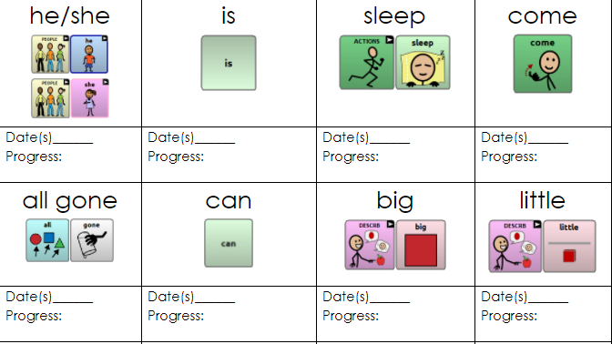
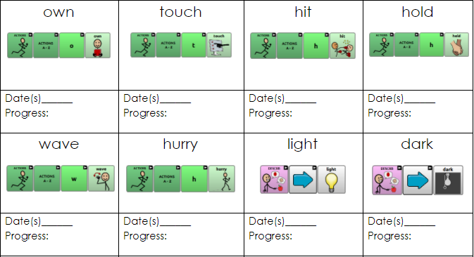
Symbol Charts for January Weeks 1 & 2 TouchChat 60 Basic
Level 1
Level 2

Slide 4
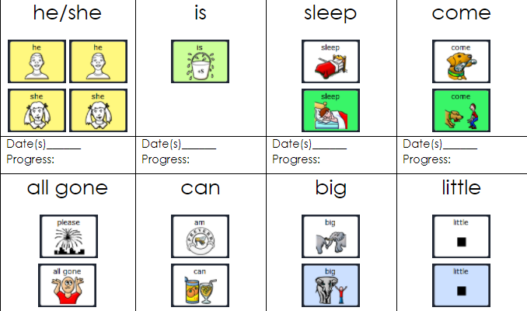
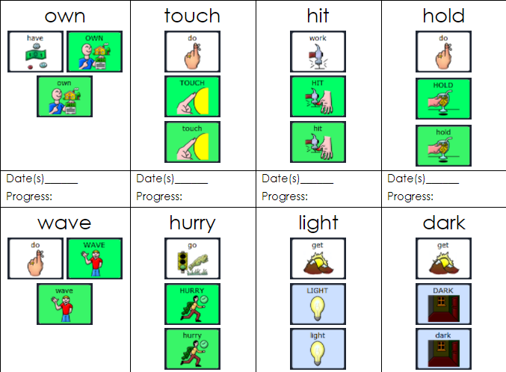
Symbol Charts for January Weeks 1 & 2 LAMP
Level 1
Level 2

Slide 5
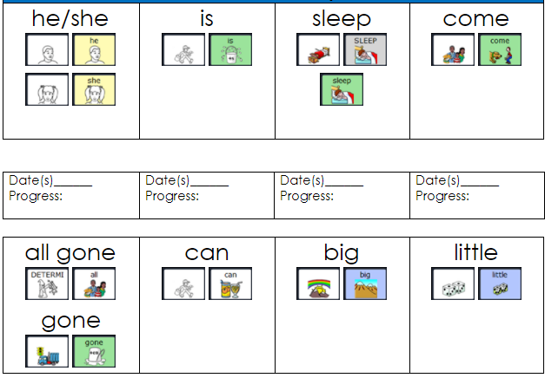
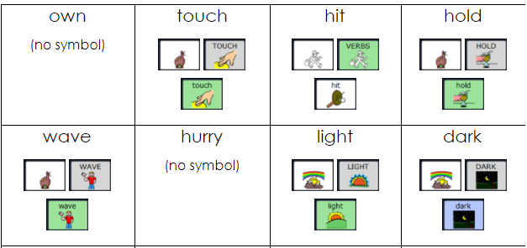
Symbol Charts for January Weeks 1 & 2 Unity 45
Level 1
Level 2

Slide 6
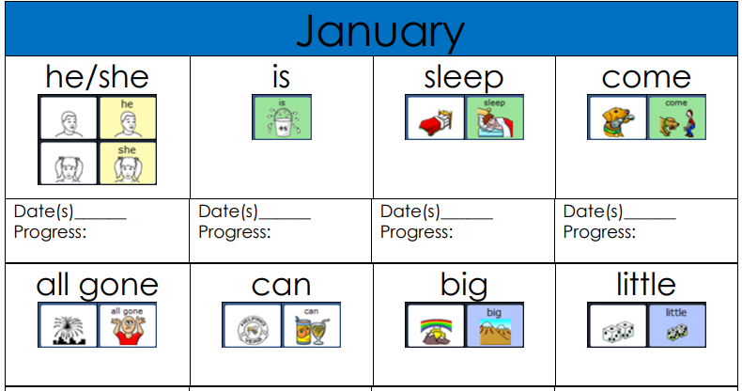
Symbol Charts for January Weeks 1 & 2 Unity 84 Seq
Level 1

Slide 7
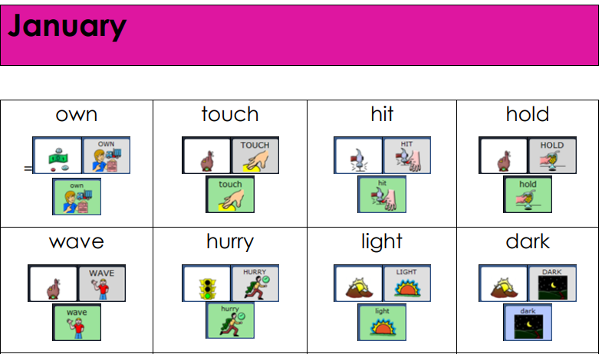
Symbol Charts for January Weeks 1 & 2 Unity 84 Seq
Level 2

Slide 8
Special Shoutout to all communication supporters of AAC and otherwise…
Please feel free to use, any, some or all of the following slides where you see fit to support your learners. The following slides work well as icebreakers at the beginning of your session/lesson.

Slide 9




Reflection time!
What did you think of this activity?
I loved it!
I liked it!
It was okay!
I didn’t like it!

Slide 10
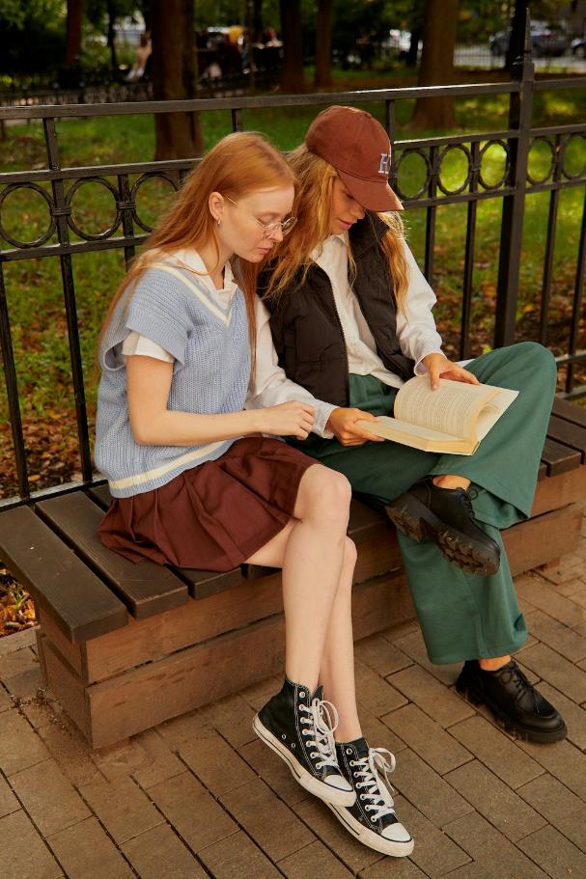
Shared Reading Suggestions
Step away from the computer screen to read together.
PAUSE
Provide students with choices of books and stories at or just above the student’s reading level.
    Books can be borrowed from the library or accessed digitally from online libraries.
After introducing the title and author of the book to the student, support students in exploring any pictures or artwork throughout the book.
    Use strategies, including aided language stimulation, wait time, expansion, recast, sentence frames (ex. “I see __.” ), asking questions, and modeling to support your student.
    Model core vocabulary using AAC, while speaking in phrases and in full, grammatical sentences.
Read the book with your student, pausing frequently to comment, pose questions and allow time for the student to comment on the story or images.
    At the end of the story, take time to reflect upon the story. Make comments and pose questions to the student about their impressions of the story and the character’s feelings.
Lead a discussion with your student about the story.
    Flip through the pages of the book, reviewing the events and your impressions, while modeling core vocabulary and providing frequent opportunities for your student to participate.
Do an art or music activity with your student that is related to the story and target vocabulary.
Lead a discussion, art, or writing activity relating elements of the story to the student’s real life experiences.
What is happening in this picture?
Where do you think they will go next?
Have you ever gone to the park? Tell me about it.
Notes:
Photo: https://www.pexels.com/photo/women-sitting-on-brown-wooden-bench-while-reading-a-book-9178821/
By Darina Belonogova

Slide 11


More Shared Reading Suggestions
PAUSE
Let’s take a deeper dive into some of these strategies
7. Take the opportunity to find and learn new words:
I. Explain the meaning of vocabulary words in context when reading
ii. Come up with synonyms and antonyms after reading and describing fringe words.
8. Encourage students to make inferences & predictions when reading and from pictures.
9. Talk about context clues when identifying feelings.
I. “How do you know they are happy/sad?” “What happened? Why are they so happy?”
ii. Have students reflect on a time when they may have felt these feelings.
10. Talk about the ending of the story/book/article?
    At the end of the story, take time to reflect on it. Make and encourage comments and pose questions to the student about their impressions of the story and the character’s feelings. (e.g. Did you like the ending? Was it a happy or sad ending? Would you want it to end in a different way?)
For more information on other Shared Reading strategies, please click on this link from the Edmonton Regional Learning Consortium
https://literacyforallinstruction.ca/shared-reading/
Notes:
Photo: https://www.pexels.com/photo/a-man-and-a-woman-reading-books-together-9572636/
By Tima Miroshnichenko

Slide 12
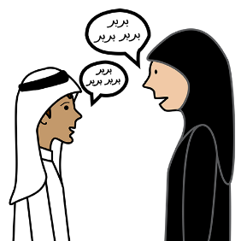


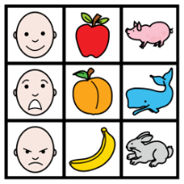
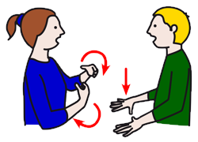

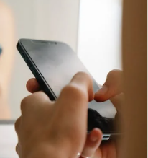

We all communicate differently and in MULTIPLE ways. What tools do you use in your communication tool box?
Low-Tech Communication Boards
Speaking
High-Tech Communication Device
Gesturing
Vocalizations
Memes/
Gifs/
Emojis
Facial Expressions
Manual Signs/Key Word Signs
Texting/DMing

Slide 13
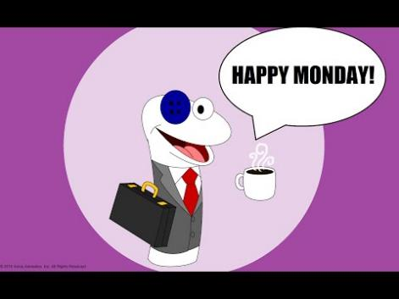
January hosts National Thank God it’s Monday, Day
Ready for today! | I’d rather be relaxing at home.
National Thank God It's Monday Day! with Pell & Mell (2016)
https://www.youtube.com/watch?v=KtPoaLru7P0&ab_channel=ArtisticAmos
By Artistic Amos

Slide 14



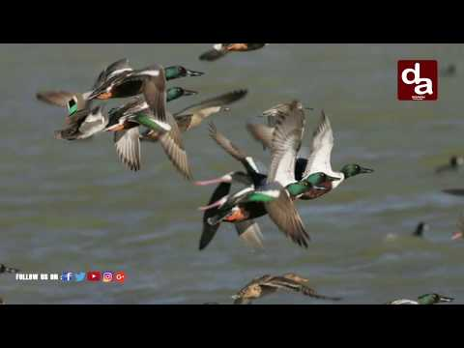
January hosts National Bird Day
What is your favorite bird?
What did you learn about birds today?
If you were a bird, which one would you be? (Or what color?)
Daily Holiday - National bird day
https://www.youtube.com/watch?v=7wQYvCcYY74&t=38s&ab_channel=WKBTTV
Courtesy of WKBT TV
National Bird Day Special |10 Amazing Facts About Birds
https://www.youtube.com/watch?v=0kJj7tOZNVY&ab_channel=Dailyaddaa
Courtesy of Dailyaddaa

Slide 15
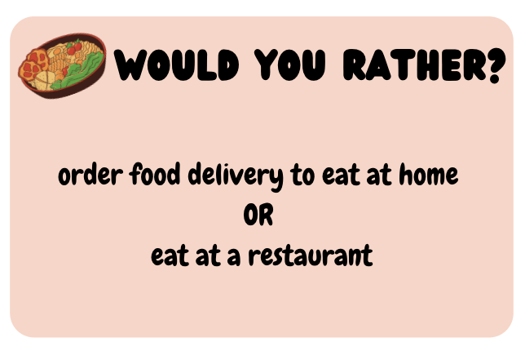

Slide 16
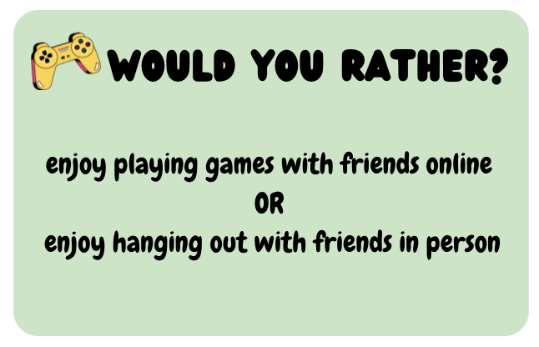

Slide 17

Let’s start out with a few jokes
QUESTION: Where can you go to practice math on New Year’s Eve?
ANSWER: Times Square
Joke obtained from: Reader’s Digest
QUESTION: What do snowmen do on New Year’s Eve?
ANSWER: Chill out.
Joke obtained from: Reader’s Digest

Slide 18
Let’s start out with a few jokes
QUESTION: Why do you need a jeweler on New Year’s Eve?
ANSWER: To ring-in the New Year.
Joke obtained from: Reader’s Digest
QUESTION: What’s a cow’s favorite holiday?
ANSWER: Moo Year’s Eve.
Joke obtained from: Reader’s Digest

Slide 19


Suggestions for utilizing the Positive and Negative Word Lists to describe their day.
After encouraging the use of verbal speech or an AAC system, the use of vocabulary word lists could be utilized to support the growth of new vocabulary.
Ask the student(s) if they feel good or bad about their day, (choosing the corresponding word list).
If this question poses a challenge, have the student point to the “thumbs up” or “thumbs down” symbol to indicate a good or bad day.
This is a long but not exhaustive list and it would be difficult to review in its entirety.
Suggestion: have students choose a letter of the alphabet to review positive or negative words starting with the the chosen letter.
If the student does not find a word that relates to their day, ask them to choose another letter.

Slide 20



Share a WORD to describe your day.
Positive Vocabulary Word List
https://www.enchantedlearning.com/wordlist/positivewords.shtml
Courtesy of Enchanted Learning
Negative Vocabulary Word List
https://www.enchantedlearning.com/wordlist/negativewords.shtml
Courtesy of Enchanted Learning

Slide 21
Tell us a story
Who
Where
When
What
What
What
How
Why
Insert a picture to evoke conversation. This approach can be used in individual or group sessions. Create WH questions based on the picture and co-construct narratives with your students. (Rice & Soto, 2009)
Insert pic
Notes:
I want.

Slide 22


Self-Care Moment- What is Self-Care?
= Taking care of yourself and your needs
What is Self Care? #AskAMAZE
https://www.youtube.com/watch?v=ThhG7_bKGQo&ab_channel=AMAZEOrg
Courtesy of Amaze Org
Notes:
https://pixabay.com/photos/self-care-health-relax-self-4778282/
https://pixabay.com/vectors/woman-self-care-care-self-love-6956139/

Slide 23

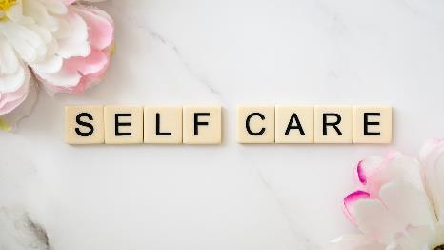

Self-Care Moment
# 1 Getting Enough Sleep
=Taking care of yourself and your needs
Sometimes we can’t help staying up late, but… waking up tired is no fun.
What do you think of these ideas?
Try to go to sleep at the same time every night.
Try getting at least 7-8 hours of sleep per night, (or more).
Limit screen time before bed.
Do you have any other ideas?
Notes:
https://pixabay.com/photos/self-care-health-relax-self-4778282/
https://pixabay.com/vectors/woman-self-care-care-self-love-6956139/

Slide 24


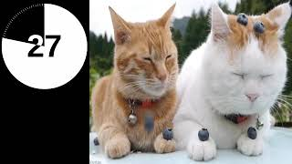
Let’s take a break for 2 minutes (Resources)
2 Minute Timer with Music - Funny/Cute Animal Edition
https://www.youtube.com/watch?v=quNKXW3maPY
Courtesy of The Time Wizard
2 Minute Timer (DOG HEAVEN)
https://www.youtube.com/watch?v=99nl9blaNuY
Courtesy of Timer Topia
[2 MIN BREAK] Sitting By Water Stream
https://www.youtube.com/watch?v=3teX3Aw8hwU
Courtesy of Daniel St.Pierre

Slide 25



Let’s take a break for 2 minutes (Resources)
2 Minute Radial Timer
https://www.youtubeeducation.com/watch?v=IRVJopSUsdc
Courtesy of PHCuber
2 Minutes of Calm Nature Sounds 2 Mins
https://www.youtube.com/watch?v=GgO6nfNEf_4
Courtesy of The Meditation Station
Two Minute Break - Short Ocean Sounds Calming Waves
https://www.youtubeeducation.com/watch?v=6eRaI_fYbZM
Courtesy of IluminarStudio

Slide 26
What Topics or Interests do you like to talk about?
Let’s see if any of you share the same ones?
NAME | NAME | NAME | NAME

Slide 27
Our Group Goals
[NAME OF GROUP] (e.g. cool cats) is working on:
List:

Slide 28

Lesson Starts Here
Pixabay Image by geralt

Slide 29

Welcome Back CLICK FOR FIREWORKS
https://www.youtube.com/watch?v=by8Gt96pq58&ab_channel=RuneLilleeng
“Short fireworks show (FWSim)” by Rune Lilleeng
Notes:
Image Source: Slideshare
https://www.slideshare.net/GoogleDeveloperStude8/introduction-to-android-study-jams

Slide 30

Learning new WORDS can be fun and interesting!!!
Image from Pixabay by
Clker-Free-Vector-Images
Notes:
https://pixabay.com/vectors/freedom-jump-reach-silhouettes-307791/

Slide 31

Happy New Year!
Photo by Pixabay
By cocoparisienne

Slide 32
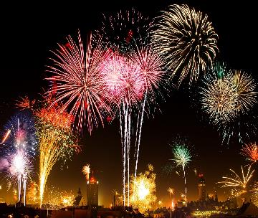
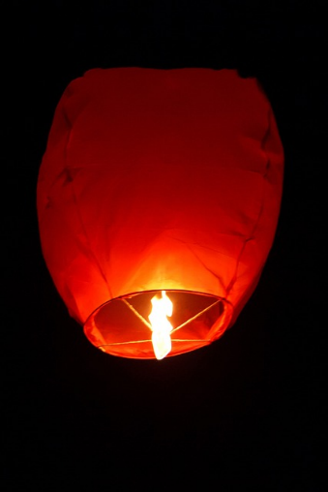


We’ll be talking about many things, including New Year’s Day & Chinese New Year.
Photo by Pixabay
nck_gsl
New Year's Resolutions
Photo by Pixabay
Public Domain Pictures
Photo by Pixabay
USA-Reiseblogger
Chinese New Year
New Year’s Day

Slide 33
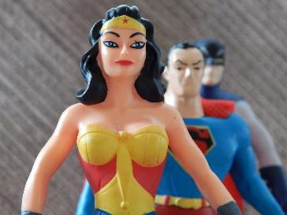


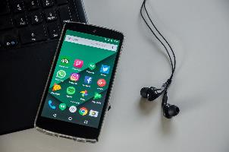
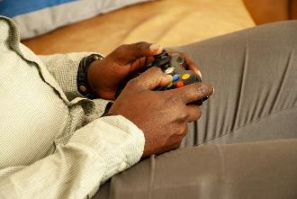
We will also learn about: Cartoon characters, Superheroes, Video Games, Virtual Reality, iPads, Apps, Assistive technology, Augmented Reality, Media, CGI…And MORE!
Photo by Pixabay
Alexas-Fotos
Photo by Pixabay
ErikaWittlieb
Superheroes
Virtual Reality
Cartoon Characters
Photo by Pixabay
geralt
Photo by Pixabay
marsjo
Apps/ Social Media
Photo by Pixabay
USA-Reiseblogger
Video games

Slide 34







And as always, we will learn about ourselves and our relationships through Social-Emotional Learning
Social-Emotional learning curriculum
Communities
Self- Management
Self- Awareness
School Culture
Families & Caregivers
Social & Emotional Learning
Decision- Making
Social- Awareness
Authentic Participation
Schools & Classrooms
Relationship
Skills
Learning Opportunities
Notes:
Images from Opensymbol.org

Slide 35
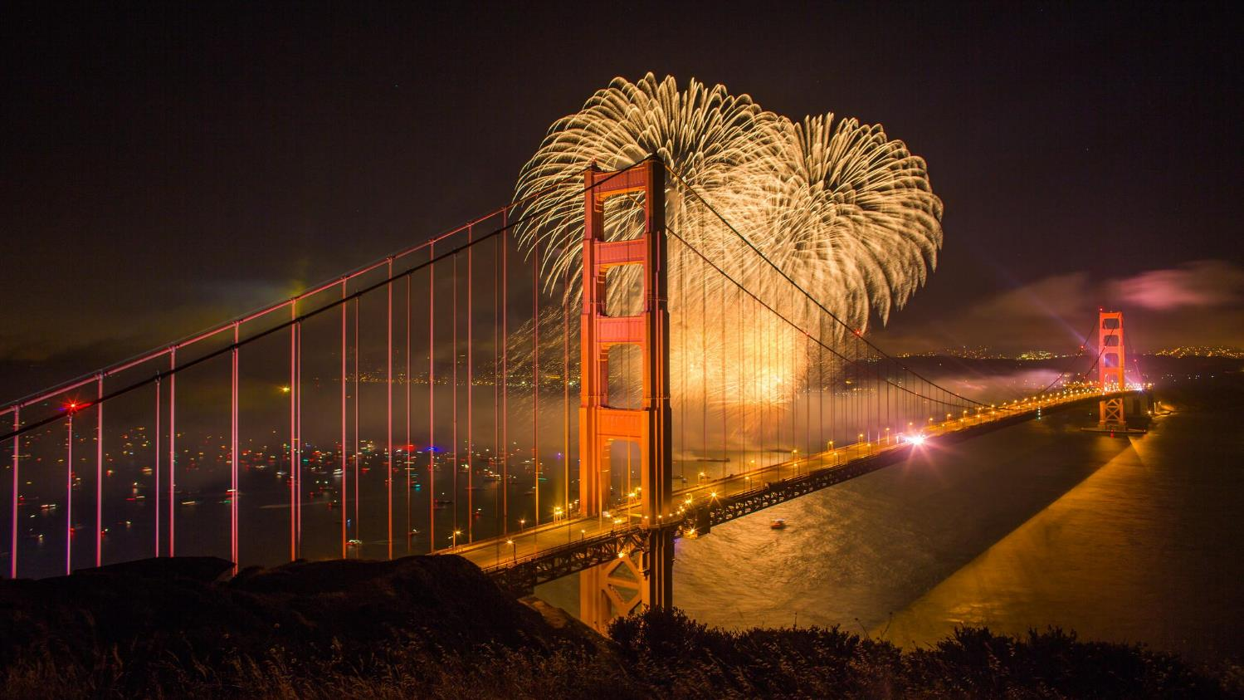
Let’s learn and celebrate, together!!
Notes:
Photo credit: Thomas Hawk via Flickr
www.flickr.com/photos/thomashawk/31692906428/in/album-721...

Slide 36


There are so many words we can say! January Weeks 1 & 2
LEVEL 1
he/she
big
all gone
sleep
can
little
is
Notes:
Girl : https://www.pngall.com/tag/girl/
Boy: https://www.shutterstock.com/video/clip-23666167-thinking-pensive-black-man-on-white-background?consentChanged=true
Contributor: Stockbakery

Slide 37
There are so many words we can say! January Weeks 1 & 2
own
LEVEL 2
hit
hold
touch
hurry
wave
light
dark
Notes:
Girl : https://www.pngall.com/tag/girl/
Boy: https://www.shutterstock.com/video/clip-23666167-thinking-pensive-black-man-on-white-background?consentChanged=true
Contributor: Stockbakery

Slide 38

Let’s say, ‘hi’ to each other and wave hello!
Notes:
Image source: Zen Chung
https://www.pexels.com/photo/happy-woman-waving-goodbye-5537576/

Slide 39

How?
are you feeling?
Ask a friend: How are you? Tell your friends: I feel ____ because _____.
Source: Open Moji

Slide 40
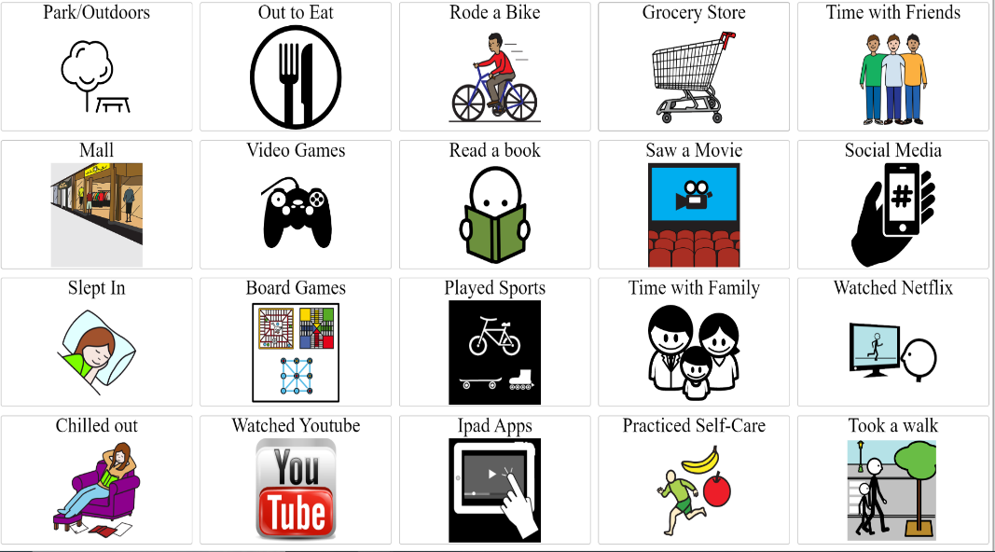
What did you this week/weekend?
Student:
Student:

Slide 41



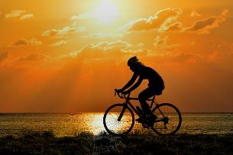
Happy New Year’s Day! How did you spend this special day?
I spent this day ________
I spent this day ________
I spent this day ________
I spent this day ________
I spent this day ________
Photo by Pixabay
HuyNgan
Relaxing
Meditating
Photo by Pixabay
StockSnap
Writing goals for the new year
Photo by Pixabay
MabelAmber
Photo by Pixabay
USA-Reiseblogger
Exercising

Slide 42
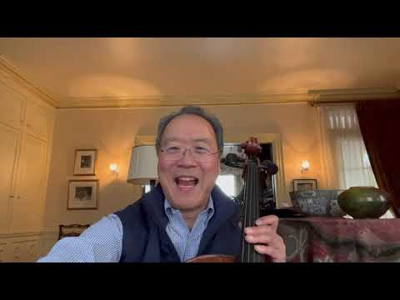


Happy New Year!! This song, “Auld Lang Syne” is a hit on this big holiday.
Happy New Year
-Yo-Yo Ma
https://www.youtube.com/watch?v=fA9osfZu0jc&ab_channel=Yo-YoMa
Courtesy of Yo-Yo Ma
Auld Lang Syne (The New Year's Anthem, Fireworks
- Mariah Carey
https://www.youtube.com/watch?v=Aop6YF1Xqqg&ab_channel=MariahCareyVEVO
(courtesy of Mariah Carey)
The Tenors - Auld Lang Syne (Official Video)
https://www.youtube.com/watch?v=6lMlGDZ5xBo&ab_channel=TheTenorsVEVO
Courtesy of the Tenors

Slide 43

Let’s read a book, titled, Happy New Year!
Click symbol to read book, and please note to turn on the speech in the upper right corner/gear
Happy New Year: by Barton, Tar Heel Reader. (Please make sure to turn the speech on)
https://tarheelreader.org/2019/01/02/happy-new-year-8/

Slide 44

Different cities use light to celebrate New Years in different ways! Which one is your favorite?
I liked seeing the lights in ___________
I liked seeing the lights in ___________
I liked seeing the lights in ___________
I liked seeing the lights in ___________
I liked seeing the lights in ___________
New Year’s celebrations from around the world
https://www.youtube.com/watch?v=J4PkWo2crWM&ab_channel=ABCNews
Courtesy of ABC News

Slide 45
Ways we can use the word: can
ASKING QUESTIONS (e.g. Can you help me?)
PROVIDING INFORMATION (e.g. She can apply for a job.)
VOLUNTEERING/DEMONSTRATING INDEPENDENCE (e.g. I can do it.)

Slide 46

Let’s see how New Years can be celebrated in other countries…
Which New Years celebration is most interesting to you?
Why?
New Year Celebration In Different Countries
https://www.youtube.com/watch?v=h-TTCypCyvc&ab_channel=Ingla-Terra
Courtesy of Ingla-Terra

Slide 47


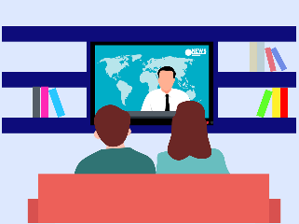
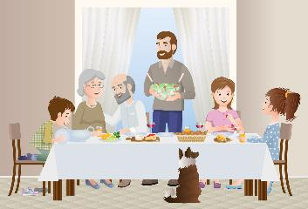
What are some things you can do to celebrate New Year’s Day?
(Example) I can relax
I can ___
I can ___
I can ___
I can ___
I can ___
Pixabay By Clker-Free-Vector-Images
Pixabay By dandelion-tea
Photo by Pixabay
Mohamad_hassan
Photo by Pixabay
dandelion-tea

Slide 48

How can you “Reset” and “Organize” your life in the new year?
How to RESET and ORGANIZE your life for 2022
https://www.youtube.com/watch?v=WZkSreDmizk&t=224s&ab_channel=k%C3%BCbriela
Courtesy of kubriela

Slide 49
Can you think of a few ideas that you liked in the video?
I liked _____ | I can do it!
I liked _____ | I can do it!
I liked _____ | I can do it!
I liked _____ | I can do it!
I liked _____ | I can do it!
I liked _____ | I can do it!

Slide 50





Photo by Pixabay
PublicDomainPictures

Slide 51

New Year's Resolutions…
At the beginning of the new year, many people like to set new goals to improve their lives.
It takes determination and hard work to take the first steps toward your goals.
Remember, you can do it with hard work and if you’re motivated to make changes.
Photo by Pixabay
Frank_Reppold

Slide 52
Let’s read a book about New Year’s Resolutions.
Click symbol to read book
New Year’s Resolutions: by Class X06, Tar Heel Reader. (Please make sure to turn the speech on)
https://tarheelreader.org/2014/01/06/new-years-resolutions-3/

Slide 53

When we set goals for the new year it is important to take little steps to achieve our big dreams.
What is your new year’s resolution?
What are some little steps you can take to achieve
your big goals?
For example, I will read 10 pages a day so I can finish my book by the end of the month.
Photo by Pixabay
by geralt

Slide 54





Let’s set goals. You can achieve them if you try!
RELATIONSHIPS/SOCIAL | WORK
SELF-CARE | HEALTH
Please make copies for individual students if you wish.

Slide 55
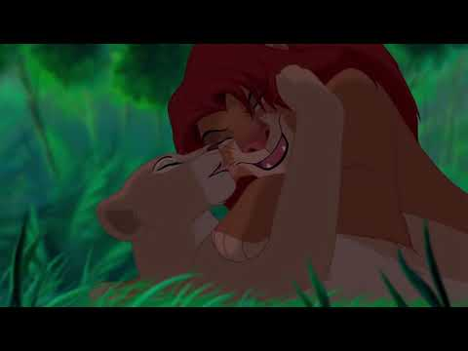
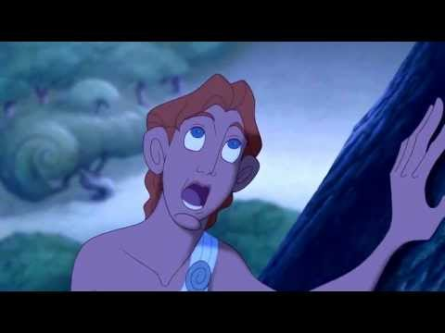
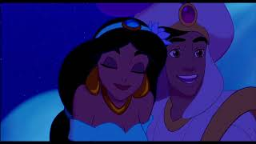
Let’s listen to a song from a cartoon with the emphasizes the word, can.
Can You Feel the Love Tonight?
- Lion King
I Can Go the Distance; -Hercules
https://www.youtube.com/watch?v=zgnHF2CwrPs&t=117s&ab_channel=lambiase1
Courtesy of lambiase1
A Whole New World - Aladdin
https://www.youtube.com/watch?v=0eWUhXPhIaE&ab_channel=GabrielM%C3%A9ndezLozano
By Gabriel Méndez Lozano
https://www.youtube.com/watch?v=25QyCxVkXwQ&ab_channel=DisneyMusicVEVO
Courtesy of DisneyMusicVEVO

Slide 56
Ways we can use the word: sleep
INSTRUCT (e.g., Close your eyes and go to sleep.)
PROVIDE/MAKE A CHOICE (e.g., You can read a book or go to sleep.)
SHARE AN IDEA (e.g., Do you want to sleep over at my house?)
SHARE PHYSICAL NEEDS (e.g., I am going to sleep off my headache.)
DIRECT ACTION (e.g. I will sleep early tonight.)
NEGATION (e.g. She can’t sleep with the lights on.)

Slide 57





Sleep is a way to let your body rest and re-energize. It keeps us healthy and functioning well!
Meditating Drinking milk Lights on or off listening to music
What helps you sleep?
Pixabay
By rauschenberger

Slide 58




Why do we need sleep?
Why Do We Need Sleep
https://www.youtube.com/watch?v=_aAmaCeq9v4&ab_channel=SciShowKids
Courtesy of SciShow Kids
Notes:
SLP can pause at different parts of the video and ask students:
-What does sleep do for your brain?
-Does sleep affect your mood during the day? How so?

Slide 59

Are you getting enough sleep? Let’s take a sleep survey!
On a scale of 1-5, how often do you get enough sleep?
What time do you usually go to sleep?
How was your sleep last night?
1 2 3 4 5
Never rarely sometimes often very often
Pixabay Image by llorcraft
8:00 pm 9:00 pm 10:00 pm 11:00 pm 12:00 am
Very poor poor average good very good
Notes:
Clinician can calculate how many hours students sleep after answering Qs #2
For Qs #3, clinician can ask why he/she rate that way? What did they do before they slept?
https://pixabay.com/vectors/sleep-sleeping-asleep-1389978/

Slide 60
Ways we can use the word: he/she
SHARE INFORMATION: He/She went to the movies yesterday and saw___.
NEGATION/DENY: He/She can’t do that
COMMENT: He/She did a great job.
ASK A QUESTION: Did he/she get back from the store yet?
ANSWER A QUESTION: He/She ate the rest of the pizza.
DISAGREE: He/she can’t do that.

Slide 61

The words he, she, and they are also known as pronouns. These words can help people express their identities!
What are your pronouns?
My pronouns are ________.
Photo by Pixabay
by susan-lu4esm
Notes:
Speech therapist can go around the room and ask students and adults what their pronouns are.
They can explain how usually boys prefer “he”, girls prefer “she”- but for folks who are gender-neutral, they may prefer “they/them” pronouns.

Slide 62

What are they doing in the virtual reality games?
He is ____________.
She is __________.
They are _________.
Seniors Try VR For The First Time - HTC Vive
https://www.youtube.com/watch?v=QvUkcw63bAs&ab_channel=VRScout
Courtesy of VRScout
Notes:
Speech therapist can pause the video multiple times to ask “What are they doing?” or “What did they think?”.

Slide 63
What games can you play? (e.g. Video, iPad apps and others).
I can play ______ | I can play ______
I can play ______ | I can play ______
I can play ______ | I can play ______
I can play ______ | I can play ______
I can play ______ | I can play ______
I can play ______ | I can play ______
I can play ______ | I can play ______

Slide 64
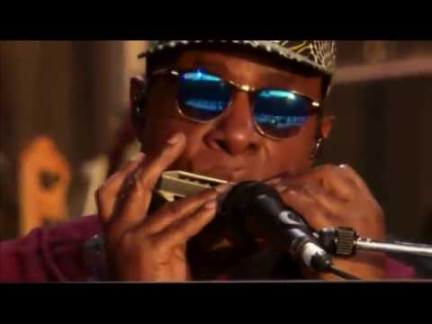
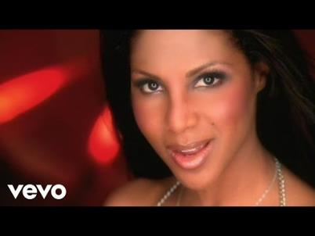
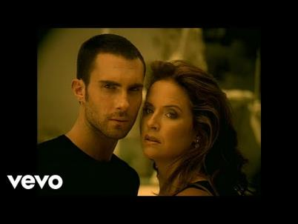
Let’s listen to a song with the words,
he or she!
Isn’t She Lovely
- Stevie Wonder (Live Performance)
https://www.youtube.com/watch?v=RfHQOlHJczU&ab_channel=PedroOrdonez
Courtesy of Pedro Ordonez
He Wasn’t Man Enough For Me
Toni Braxton
https://www.youtube.com/watch?v=9_hKXk2qSuw&ab_channel=ToniBraxtonVEVO
Courtesy of Toni Braxton
She Will Be Loved
Maroon 5
https://www.youtube.com/watch?v=nIjVuRTm-dc&ab_channel=Maroon5VEVO
Courtesy of Maroon 5

Slide 65
Ways we can use the word: is
SHARE INFORMATION (e.g. this is good)
COMPLIMENT (e.g. she is pretty)
AFFIRM (e.g. this is correct)
NEGATE (e.g. this is not my thing)

Slide 66







Is -is a magical word that can help us explain and describe
Let’s practice:
My favorite movie is
My favorite video game is
My favorite superhero is
My favorite TV show is
My favorite social media app is
My favorite thing about technology is
Photo by Pixabay
By LoboStudioHamburg

Slide 67



Tell us MORE!
Teach the group about your favorite movie/ TV show or game!
My favorite [...] is
It is my favorite because_____
It is about ___
My favorite part is when ____
My favorite character is ______
Photo by Pixabay
Mohamad_hassan

Slide 68

What is virtual reality?
Let’s watch a short video to learn how it works!
Ideas:
What is Virtual Reality?
https://www.youtube.com/watch?v=dOnPAPJNM-0&ab_channel=IAmYourTargetDemographic
Courtesy of I am your Target Demographic

Slide 69
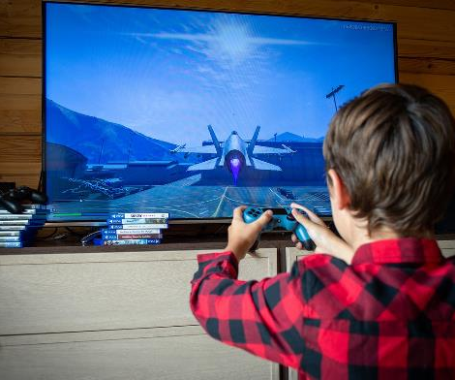
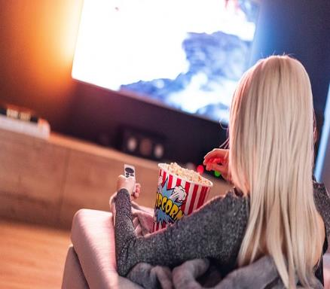
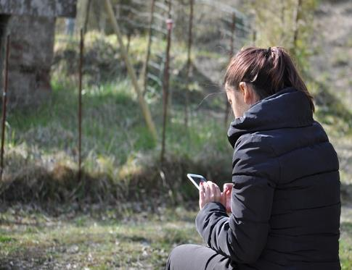
What are they doing?
He is _________
She is _________
She is _________
Photo by Pixabay
R_region
Photo by Pixabay
yousafbhutta
Photo by Pixabay
JacoTheWacko

Slide 70

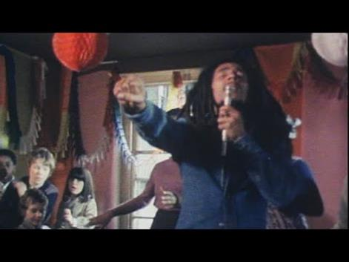

Let’s listen to some songs with the word is!
Is it True
-Tame Impala
https://www.youtube.com/watch?v=KN8nJFLu1Rk&ab_channel=tameimpalaVEVO
Courtesy of Tame Impala
Is This Love
-Bob Marley
https://www.youtube.com/watch?v=69RdQFDuYPI&ab_channel=BobMarley
Courtesy of Bob Marley
All You Need is Love
-Beatles
(from Love Actually movie)
https://www.youtube.com/watch?v=m_2q1rclwNE&ab_channel=LyndenDavidHall4ever
Courtesy ofLynLyndenDavidHall4ever

Slide 71
Ways we can use the word: come
INVITE/REQUEST (e.g., come again, please come, come play, come up, come show me)
PROTEST (e.g., no come, don’t come, don’t want to come)
TELL A STORY (e.g., when come, come first, come last, come fast, come and go)
ANSWER QUESTIONS (e.g., want to come, come now)

Slide 72
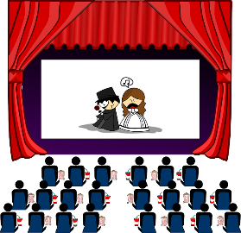


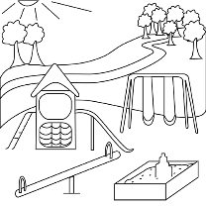
Having friends and family come with us to new places can be fun and help us feel connected!
In this New Year, where are some places you’d like friends and family to come with you to?
Pixabay by OpenClipArt-Vectors
Pixabay by Pixabay by Clovis_Cheminot

Slide 73

Let’s watch the animated short, Partly Cloudy
Why is it important that the storks come and go to the clouds?
How does the cloud feel differently each time the stork comes back? Why?
Partly Cloudy
https://www.youtube.com/watch?v=PfyJQEIsMt0&t=139s&ab_channel=gigiciarciaglini
Courtesy of gigi ciarciaglini

Slide 74
Ways we can use the word: all gone
GAIN INFORMATION: Learning about others/environment (e.g. Is it all gone?)
SHARE INFORMATION: Describe others/the environment (e.g. They have all gone away. The train has all gone through the tunnel.)
COMMENT: (e.g. Wow it is all gone!)

Slide 75

Some people eat certain foods on New Years until they are all gone. They believe this will bring them good luck!
What does your family eat for New Years until it’s all gone?
13 Lucky Foods for the New Year
https://www.youtube.com/watch?v=GMICLwPKO3c&ab_channel=RANDOMNOTES%26TIPS’
Courtesy of Random Notes and Tips

Slide 76
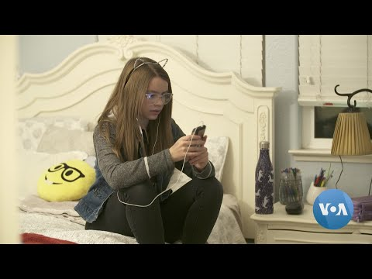
With everything becoming virtual, some of us cannot imagine what it would be like if our internet was all gone.
Let’s watch a video and think about how we might feel.
A New Phone Just for Kids: No Internet Access, No App Store
https://www.youtube.com/watch?v=lpq6TK-Hxng&ab_channel=VoiceofAmerica
Courtesy of Voice of America

Slide 77

Discussion time!
What are some pros and cons of internet access being all gone?
PROS | CONS
Pixabay by Fancycrave1
How would you feel if your internet was suddenly all gone? What would you do instead?
How would the world be different if the internet were suddenly all gone?

Slide 78
Let’s take a break with some riddles!
Riddle #1:
I have a ring, but no fingers.
Since my tail is all gone, I am with you all the time.
What am I?
Notes:
Answer: Telephone

Slide 79


Answer: A telephone!
Notes:
Image source: https://whatsthebigdata.files.wordpress.com/2017/05/mobile_vs_phones.gif

Slide 80
Riddle #2
I follow you all day long,
But when the night or rain comes,
I am all gone.
Notes:
Answer: A shadow

Slide 81

Answer: A shadow!
Image source: https://cayuse.com/wp-content/uploads/2014/04/shadow-of-man-on-ground.jpg
Notes:
Image source: https://cayuse.com/wp-content/uploads/2014/04/shadow-of-man-on-ground.jpg

Slide 82
Let’s read a book about Chinese New Year.
Click symbol to read the book to and with your student. Teacher/Friend, therapist or Student can select symbols below the book to make comments.
It’s Chinese, (Lunar) New Year: by Cforat, Tar Heel Shared Reader.
https://shared.tarheelreader.org/shared/read/having-a-wonderful-chinese-new-year-2
Click on the green speech bubble in the upper left corner to see options for displaying communication symbols. (turn on/off symbols to be displayed depending on your student or group)

Slide 83

What is Chinese New Year?
Bet You Didn't Know: Chinese New Year | History
https://www.youtube.com/watch?v=asluM20g6rk&t=1s&ab_channel=HISTORY
Courtesy of History

Slide 84
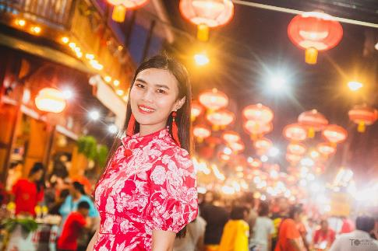

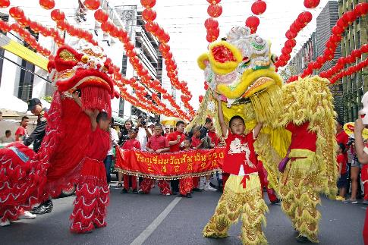
Chinese New Year is fun!
Pixabay By akkasit_tom
Pixabay By ida20150101
Pixabay By Wiroj

Slide 85
How can people prepare for Chinese New Year?
People can clean their house.
People can __

Slide 86

What is Motivation?
https://tech-lagoon.com/imagechef/en/image-to-edge.html
What does motivation mean to you?
What are you motivated to do?
If you are motivated, do you think that you CAN do it?
What is Motivation?
https://www.youtube.com/watch?v=KfEZbGT3aWs&ab_channel=TerryWadeThompson
Courtesy of Terry Wade Simpson

Slide 87
Ways we can use the word: big
DESCRIBE (e.g. eat big, jump big, open big)
TELL A STORY (e.g. big party, big day)
EXPRESS FEELING (e.g. big sad, big mad, big hurt)
SHARE AN IDEA (e.g. big tell, big idea)

Slide 88
Ways we can use the word: little
DESCRIBE (e.g. eat little, jump little, little dog, little sister)
EXPRESS FEELING (e.g. little sad, little mad, little hurt)
REMIND (e.g. one little thing, little problem)
NEGOTIATE (e.g. little broccoli, run little)

Slide 89

The word, big can describe things that are tall, wide, massive, or plentiful. It can also describe something very important (like your dreams)!
What are your big dreams for the future?
My big dream is to become a speech therapist! (ex.) | My big dream is___.
My big dream is___. | My big dream is___.
My big dream is___. | My big dream is___.
Pixabay by PublicDomainPictures

Slide 90


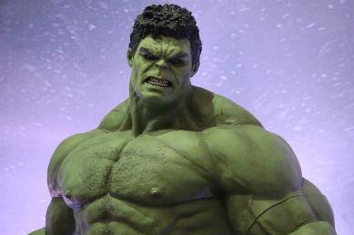

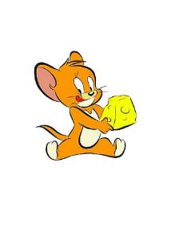
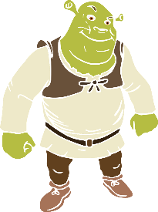


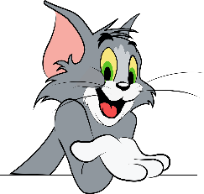
Which character is bigger?
Photo by Pixabay
Gounder and Spiderman Yanazdt
Pixabay by Inspired Images
Or Or
Or Or
AI
Photo by Pixabay
Artrose
Photo by Pixabay
Mohamad_hassan
Photo by Pixabay
Nextpraveen
Pixabay by Inspired Images

Slide 91
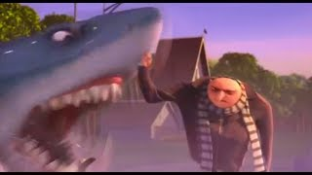


Let’s listen to a song from a cartoon or movie you like!
Despicable Me Bad Bad Day Music Video
https://www.youtube.com/watch?v=facCaJzxcZo&ab_channel=Braegon
Courtesy of Braegon
You Are My Home
Alvin and the Chipmunks
https://www.youtube.com/watch?v=74LGO37SvmQ&ab_channel=Chris%27UnitedContent
Courtesy of Chris’ United Content
Hot Chocolate
Polar Express
https://www.youtube.com/watch?v=KPWYu94mzhE&ab_channel=KeithSpencer
Courtesy of Keith Spencer

Slide 92

In the New Year let’s put things into perspective…
We can ask ourselves, Is it a Big deal or Little deal?
Pixabay, by Twinster
Sometimes, we encounter challenging situations and we tend to have a big reaction to little problems.
A big deal affects something very important and you will most likely need help solving it.
A little deal is something that you can solve yourself because it does not affect others.
Notes:
IIt is important to learn appropriate coping skills and know how to respond to these situations

Slide 93

Big deal or Little deal?
Big deal | Little Deal
You are hurt. | Someone hurt your feelings.
Someone is being bullied. | You lost a game.
There is danger nearby. | There is no time to relax.
Pixabay, by Twinster
Notes:
IIt is important to learn appropriate coping skills and know how to respond to these situations

Slide 94


What should you do?
Call 911
Big deal | What should you do?
1. You are hurt
2.Someone is being bullied
3.There is danger nearby
Little deal | What should you do?
1. Someone hurt your feelings | 1.
2.You lost a game | 2.
3.There is no time to relax. | 3.

Slide 95



Let’s listen to some songs with the word big!
Big Girls Don’t Cry
-Fergie
https://www.youtube.com/watch?v=agrXgrAgQ0U&ab_channel=FergieVEVO
Courtesy of Fergie
Something Big
- Shawn Mendes
https://www.youtube.com/watch?v=mytLRy32Viw&ab_channel=ShawnMendesVEVO
Courtesy of Shawn Mendes
Big Big World
Emilia
https://www.youtube.com/watch?v=wpkS2DU_qMs&ab_channel=EmiliaVEVO
Courtesy of EmiliaVEVO

Slide 96

What do you think of the movie “Little”?
She was a big boss, but she became a little ______.
What things did she have to do when she became little?
What are some things that little kids do that big adults don’t?
Little - Official Trailer 1 (Universal Pictures) HD
https://www.youtube.com/watch?v=Dk6jGQXx3o0&ab_channel=UniversalPicturesUK
Courtesy of Universal Pictures UK

Slide 97
Ways we can use the word: own
SHARE INFORMATION (e.g. I own this)
ASK QUESTION (e.g. do you own this?)
COMPLIMENT (e.g. you owned the dance floor)
NEGATE (e.g. I don’t own this)

Slide 98

Take ownership over your talker!
Whether you communicate using your voice, sign language, or a device, you are the owner of your words.
What you have to say is important, so the way you say it is important too.

Slide 99
Take ownership over your talker!
One great way to OWN your device is to customize it!
Let’s add words that are important to you:
People
Foods
Games
Places
And so much more!

Slide 100

Do you own movies or video games? Or do you prefer to rent, stream, or download them?
I own ______ | I do not own ____. | Instead I use ____.
Pixabay by Jarmoluk

Slide 101



Let’s listen to some songs with the word, own!
On my Own
-Ross Lynch
https://www.youtube.com/watch?v=ZFRMOG82SF0&ab_channel=DisneyMusicVEVO
Courtesy of DisneyMusicVEVO
Own it
-STORMZY - OWN IT (feat. ED SHEERAN & BURNA BOY)
https://www.youtube.com/watch?v=eYwbGaSurCQ&ab_channel=Stormzy
Courtesy of Stormzy
Go Your Own Way
-Fleetwood Mac
https://www.youtube.com/watch?v=ozl3L9fhKtE&ab_channel=FleetwoodMac
Courtesy of Fleetwood Mac

Slide 102
Ways we can use the word: touch
REQUEST (e.g. Please, do not touch)
QUESTION (e.g. Have you kept in touch? Can I touch it?)
INSTRUCT (e.g. Touch the home button.)
COMMENT (e.g. I can touch my toes. I've lost my touch.)

Slide 103


Device/Talker Tour!!
How well do you know your device/talker?
Where do you touch to turn on/unlock your talker?
Where do you touch to change the volume?
Can you touch the icon that shows your talker’s battery?
Notes:
Have student point or touch the requested areas on their device/talker.

Slide 104



Have you ever…
Touched snow? | I have touched / I have not touched
Touched a snake?
Touched a starfish?

Slide 105



Let’s listen to a song with the word touch!
U Can’t Touch This
- MC Hammer
https://www.youtube.com/watch?v=Be886Ezi30g&ab_channel=Enjoyit%F0%9F%A4%8D
Courtesy of Enjoy it
Touch
Little Mix
https://www.youtube.com/watch?v=gBAfejjUQoA&ab_channel=littlemixVEVO
Courtesy of Little Mix
Touch It
- Ariana Grande
https://www.youtube.com/watch?v=60QQAw22J4I&ab_channel=CarlosPaglieri
Courtesy of Carlos Paglieri

Slide 106
Ways we can use the word: hit
DIRECT ACTIONS (e.g. hit it (i.e. play it), hit ball, hit long, hit close)
DESCRIBE (e.g. big hit, fast hit)
SHARE INFORMATION (e.g. boy hit ball, cat hit toy)
SHARE AN IDEA (e.g. hit me (i.e. tell me))

Slide 107



What are they hitting?
He _________.
The kittens _____.
____ the target.
Pixabay Keithjj
Pixabay by Mohamad_hasan
Pixabay by Michelle_Raponi

Slide 108

Do you hit things when you’re angry?
Pixabay by MickeyLIT
Yes, when I’m angry I hit ________.
No, I don’t hit when I’m angry.
Notes:
Clinicians can have an open discussion on how to manage anger instead of physically expressing the negative feeling.

Slide 109



Sometimes when we feel angry, we can-Stop, Think and Plan what to do.
We can-
STOP
THINK
&
PLAN…what to do next?
When we Stop and Think we can calm down or take a break by:
Taking a walk
Listening to music
Talk to a friend teacher or parent
Read
Taking a run
Watch a funny video
Writing in a journal
What other ideas do you have?

Slide 110

Let’s watch this video and when you’re ready for me to press play, say “Hit it!”!
Minions Full Animated Short Film "The Competition" HD
https://www.youtube.com/watch?v=W7LWny6c4wI&t=3s&ab_channel=ZeroMedia
Courtesy of Zero Media

Slide 111
Ways we can use the word: hold
COMMENT: (e.g. You can hold out for the right job.)
REQUEST: (e.g. Can I hold the baby?)
COMMAND: (e.g. Hold the bags, please. Or Hold your head up with pride.)
ANSWER QUESTIONS: (e.g. How are you holding up?)
ASK QUESTIONS (e.g. Did you have to hold your tongue and not say what you wanted?)
COMPLAIN (e.g. I don’t want to hold this.)
DIRECT ACTION: (e.g. Please hold the baby.)

Slide 112
Let’s read a book about Gaming.
Click symbol to read book
Gaming: by Agellerm , Tar Heel Reader. (Please make sure to turn the speech on)
https://tarheelreader.org/2023/05/24/gaming-3/

Slide 113






There are many different ways to hold gaming controllers!
XBOX adapted controller with switch
Wii One-hand controller
VR motion-tracking controller
Adapted two-hand controller
Two-hand phone game
PS Two-hand controller
Pixabay: WikiMediaImages, Julientromeur, KD_Buck, jackinsbox, OpenClipart-Vectors
Notes:
https://pixabay.com/photos/video-game-console-video-game-play-2202660/
https://pixabay.com/illustrations/man-baroque-gentleman-french-7900704/
https://pixabay.com/photos/xbox-video-game-video-game-console-7460944/
https://pixabay.com/vectors/controller-joystick-playstation-161579/
https://pixabay.com/photos/telephone-games-technology-3001349/

Slide 114

Check out this awesome Xbox controller!
Do you think it is important to give everyone access to video games regardless of how they hold their controller?
Why?
Xbox Adaptive Controller Review
https://www.youtube.com/watch?v=MHOYQQTvQu4&ab_channel=AllAccessLife
Courtesy of All Access Life
Check out even more ways to hold your gaming controllers here → AbleGamers

Slide 115




Do you play video games? If so, how do you hold your controller?
I hold a controller with my
I hold it with my
I hold it with my
I hold it with my
I hold it with my
I hold it with my
I hold it with my
I hold it with my
Pexels JEshoots.com
Pexels Stas Knop
Pexels Matheus Bertelli
Pexels Beata Dudova
Notes:
https://www.pexels.com/photo/two-people-holding-black-gaming-consoles-442576/
https://www.pexels.com/photo/black-microsoft-xbox-game-controller-1298601/
https://www.pexels.com/photo/person-playing-candy-crush-on-nokia-smartphone-228963/
https://www.pexels.com/photo/gaming-on-logitech-peripherals-and-samsung-odyssey-g40-monitor-at-computer-trade-fair-18966469/

Slide 116


This character is holding in his emotions. If you were in his shoes, would you talk about how you feel or hold it in?
Talk about it? | Hold it in?
In a Heartbeat- Animated Short Film
https://www.youtube.com/watch?v=2REkk9SCRn0&ab_channel=InaHeartbeatAnimatedShortFilm
Courtesy of In a Heartbeat
Who in your life would you turn to, to talk about your feelings?

Slide 117



Let’s listen to some songs with the word, hold!
Hold on
-Justin Bieber
https://www.youtube.com/watch?v=LWeiydKl0mU&ab_channel=JustinBieberVEVO
Courtesy of Justin Bieber
Hold on, We’re Going Home
-Drake
https://www.youtube.com/watch?v=GxgqpCdOKak&ab_channel=DrakeVEVO
Courtesy of Drake
Hold on For One More Day
-Wilson Phillips
https://www.youtube.com/watch?v=uIbXvaE39wM&ab_channel=WilsonPhillipsVEVO
Courtesy of Wilson Phillips

Slide 118
Ways we can use the word: wave
GREET (e.g. I like to wave hello, *waves* hello!)
GET ATTENTION (e.g. Hello!!! I’m waving my arms at you)
COMMENT (e.g. That is a big wave)
DISCUSS AN INTEREST (e.g. Do you like surfing? I like to watch people ride the big waves)

Slide 119

Welcome back! Let’s wave ‘hello’ to one another!

Slide 120

Wow! We are experiencing a WAVE of new technology! Let’s sort advantages and disadvantages of the tech wave!
ADVANTAGE! | DISADVANTAGE
Meeting people from around the world
Spread of misinformation
Access to movies, TV, and videos
Easy access to information
Speech-Generating Devices
Social isolation/loneliness
Comparing ourselves to others
Social Media Addiction
Reducing use of paper
Online communities

Slide 121


What is Wi-Fi?
It lets us send information through radio waves!
What do you do through radio waves?
That's How Wifi Works
https://www.youtube.com/watch?v=hePLDVbULZc&ab_channel=BRIGHTSIDE
Courtesy of the Bright Side
(can pause around 5:12)
Notes:
3D ICONS: https://3dicons.co/

Slide 122



Let’s listen to some songs with the word, wave!
Wave
-Mr. Probz, feat. Robin Schulz
https://www.youtube.com/watch?v=pUjE9H8QlA4&ab_channel=mrprobzVEVO
Courtesy of Mr. Probz
Waves
-Miguel, Travis Scott
https://www.youtube.com/watch?v=4lnykmCFjFs&ab_channel=MiguelVEVO
Courtesy of Miguel
Heat Waves
-Glass Animals
https://www.youtube.com/watch?v=mRD0-GxqHVo&ab_channel=GlassAnimalsVEVO
Courtesy of Glass Animals

Slide 123
Ways we can use the word: hurry
COMMENT: (e.g., No need to hurry, we have enough time. Hurry, it’s time to go to our next class!)
ASK A QUESTION: (e.g. Did you hurry out the door this morning, or did you take your time?)
SHARE INFORMATION: (e.g. I was in a hurry and forgot my pencil).

Slide 124


How was your morning?
Did you hurry out the door this morning?
Did you take your time?
OR
Pixabay Clker-Free-Vector-Images
Pixabay By tienhoang1199

Slide 125


Some video games make us hurry to beat the clock!
What are some of your favorite games where we need to hurry?
My favorite game is ______.
My favorite game is ______.
My favorite game is ______.
My favorite game is ______.
My favorite game is ______.
Pixabay OpenClipArt-Vectors
Pixabay By DG RA
Notes:
Sonic the Hedgehog: https://cdn.cloudflare.steamstatic.com/steam/apps/71113/ss_e657ecd50d623a95919cbd1f5474e33750e5a3ad.1920x1080.jpg?t=1571827880

Slide 126
Ways we can use the word: light
DESCRIBE (e.g. this object is light)
COMPLIMENT (e.g. your light shines bright)
REQUEST (e.g. please turn on the light)
ASK A QUESTION (e.g. is this heavy or light)

Slide 127
Ways we can use the word: dark
SHARE INFORMATION (e.g. it’s dark in here)
ASK QUESTION (e.g. is this dark enough?)
REQUEST (e.g. make it dark in here)
AFFIRM (e.g. yes, I like dark chocolate)
DESCRIBE (e.g. it’s dark)

Slide 128






What are some of your favorite things we can only do when it’s dark?
Let’s make a collage
Pixabay images by: Noel-Bouza, PublicDomain Pictures, Black out photography, Clkr-Free Vector Images, OkayGordon, and HtcHnm

Slide 129






What are some things we might use light for?
Let’s make a collage
Pixabay image by: Arciaon

Slide 130
How can we ask someone to make it dark?
Is it too bright in here?
Turn on?
Turn off?
Yes, can you____?

Slide 131

Let’s watch a video about when it’s dark vs light outside!
Day and Night
https://www.youtube.com/watch?v=wmk9uFGRCRw&ab_channel=IvanAbrego
Courtesy of Ivan Abrego
Would you rather have it be light outside all the time or dark outside all the time?

Slide 132



People might gift or eat chocolate on New Years!
Which type of chocolate is your favorite?
How does it taste different from the others?
White chocolate
Milk chocolate
Dark chocolate
# of Votes_____
# of Votes_____
# of Votes_____

Slide 133
Some objects can be heavy and other objects can be light! Which objects are heavy and which objects are light?
LIGHT | HEAVY
iPhones
Gallon of milk
Elephant
Textbooks
Hummingbird
Cup of water
Feathers
Computer Monitors
A piece of paper
Watermelons

Slide 134



Let’s listen to some songs with the word, light!
Blinding Lights
-The Weekend
https://www.youtube.com/watch?v=fHI8X4OXluQ&ab_channel=TheWeekndVEVO
Courtesy of the Weeknd
I See the Light
-Mandy Moore and Zachary Levi
https://www.youtube.com/watch?v=ILRs2r6lcHY&ab_channel=DisneyMusicVEVO
Courtesy of DisneyMusicVEVO
New Light
-John Mayer
https://www.youtube.com/watch?v=mQ055hHdxbE&ab_channel=JohnMayer
Courtesy of John Mayer

