Slide 1
Topic cards
PrAACtical AAC
www.PrAACticalAAC.org

Slide 2
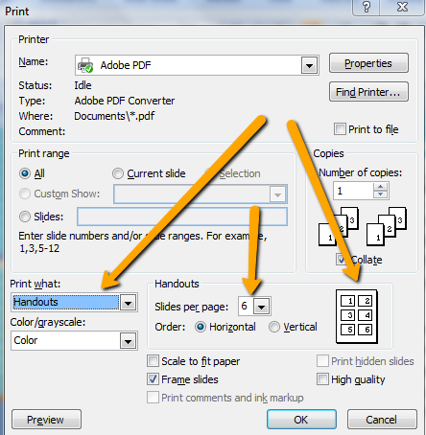
Using these Topic Cards
These cards are designed for people whose speech is unclear. They can use cards like indicate the topic of the message before telling the actual message so that the listener can better guess their intent. E.g., School + ‘Nobuck’ might be ‘notebook’
Directions:
Download & save the file.
Modify, as needed.
For printing, select the handout option. Set desired number of slides per page based on the size you want. Print the slide version for a full-sized copy.
Print & laminate.
Teach the communicator to either spell out
the message OR point to the first letter of
the word they are saying.
Attribution: Please feel free to share with families &
colleagues using professional standards for attribution.
These materials were created by PrAACtical AAC
(www.PrAACticalAAC.org).

Slide 3
Person | Place | Thing | Something Else
Family | Home | Looks like | Important
Friend | School | Used for | Not Important
Someone else | Somewhere else | Something else | I don’t know.
Feeling | Time | Medical | Problem
Good | Now | Pain | Health
Bad | Later | Medicine | Appointment
Something else | Past | Something else | Something else

Slide 4
Person | Place | Thing | Something Else
Family | Home | Looks like | Important
Friend | School | Used for | Not Important
Someone else | Somewhere else | Something else | I don’t know.
Feeling | Time | Medical | Problem
Good | Now | Pain | Health
Bad | Later | Medicine | Appointment
Something else | Past | Something else | Something else

Slide 5
People | Places | Thing | Time | Question | Describe | Action
Family | Home | Food | Now | Who? | Looks like | Need or Want
Friends | School | TV | Before/ Past | What? | Used for | Help
Classmate | Work | Radio/ Music | Later/ Future | When? | Size | Tell
Co-worker | Shopping | Transpor-tation | Minutes or Hours | Where? | Shape | Do
Medical | Medical | Phone | Week or Month | How? | Location | Fix
Community | Community | Computer | Year | Why? | Something I have | Talk about
Something else | Something else | Something else | Something else | Something else | Something else | Something else

Slide 6
People | Places | Thing | Time | Question | Describe | Action
Family | Home | Food | Now | Who? | Looks like | Need or Want
Friends | School | TV | Before/ Past | What? | Used for | Help
Classmate | Work | Radio/ Music | Later/ Future | When? | Size | Tell
Co-worker | Shopping | Transpor-tation | Minutes or Hours | Where? | Shape | Do
Medical | Medical | Phone | Week or Month | How? | Location | Fix
Community | Community | Computer | Year | Why? | Something I have | Talk about
Something else | Something else | Something else | Something else | Something else | Something else | Something else

Slide 7
People | Places | Thing | Time | Question | Describe | Action
Mom | Home | Food | Now/ Today | Who? | Looks like | Need or Want
Dad | School | TV/DVR | Before/ Yesterday/Past | What? | Used for | Help
Brother or Sister | Park | Books or Music | Later/ Tomorrow/Future | When? | Size | Tell
Grandma or Grandpa | Library | Car | Minutes or Hours | Where? | Shape | Do or Watch
School Friend | Store | Video Game | Week or Month | How? | Location | Play
Other Friend | Camp | Computer | Year | Why? | Something I have | Talk about
Someone else | Some-place else | Something else | Something else | Something else | Something else | Something else

Slide 8
People | Places | Thing | Time | Question | Describe | Action
Mom | Home | Food | Now/ Today | Who? | Looks like | Need or Want
Dad | School | TV/DVR | Before/ Yesterday/Past | What? | Used for | Help
Brother or Sister | Park | Books or Music | Later/ Tomorrow/Future | When? | Size | Tell
Grandma or Grandpa | Library | Car | Minutes or Hours | Where? | Shape | Do or Watch
School Friend | Store | Video Game | Week or Month | How? | Location | Play
Other Friend | Camp | Computer | Year | Why? | Something I have | Talk about
Someone else | Some-place else | Something else | Something else | Something else | Something else | Something else

Slide 9
People | Places | Thing | Time | Question | Describe | Action
Mom or Dad | Home | Food | Now/ Today | Who? | Looks like | Need or Want
Teacher | School | Books or Reading Stuff | Before/ Yesterday/Past | What? | Used for | Help Me
Aide | Bus | Writing Stuff | Later/ Tomorrow/Future | When? | Size | Tell or Ask
Therapist | Library | Back-pack | Minutes or Hours | Where? | Shape | Do or Watch
School Friend | Cafeteria | Talker | Week or Month | How? | Location | Play or Work
Other Friend | Playground | Computer | Year | Why? | Something I have | Talk about
Someone else | Some-place else | Something else | Something else | Something else | Something else | Something else

Slide 10
People | Places | Thing | Time | Question | Describe | Action
Mom or Dad | Home | Food | Now/ Today | Who? | Looks like | Need or Want
Teacher | School | Books or Reading Stuff | Before/ Yesterday/Past | What? | Used for | Help Me
Aide | Bus | Writing Stuff | Later/ Tomorrow/Future | When? | Size | Tell or Ask
Therapist | Library | Back-pack | Minutes or Hours | Where? | Shape | Do or Watch
School Friend | Cafeteria | Talker | Week or Month | How? | Location | Play or Work
Other Friend | Playground | Computer | Year | Why? | Something I have | Talk about
Someone else | Some-place else | Something else | Something else | Something else | Something else | Something else

