Slide 1
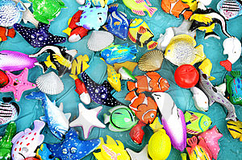
Talking and Playing About Sea Animals

Slide 2
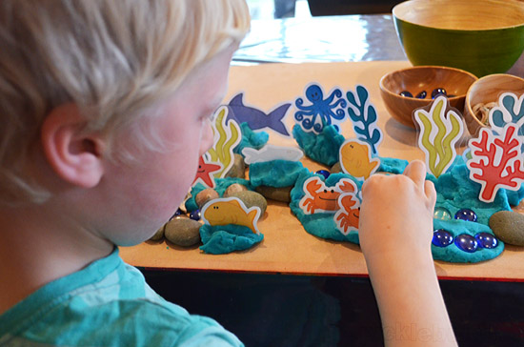
We are going to talk and play about sea animals.
Sea animals are very cool.

Slide 3
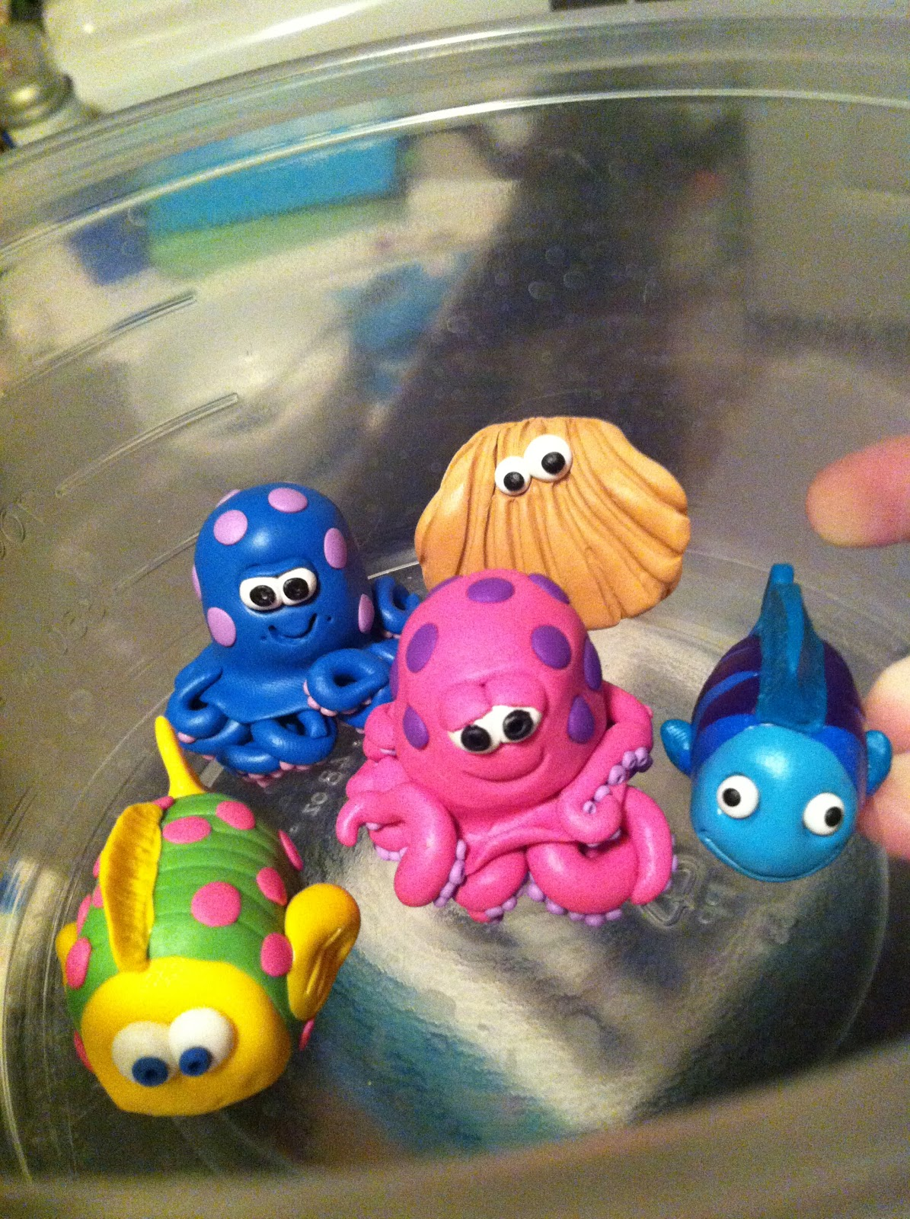
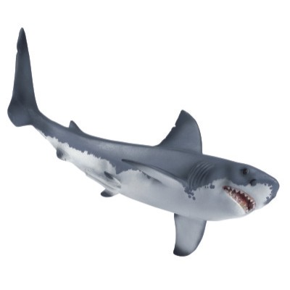
There are lots of sea animals. We will probably see and play with whale toys, shark toys, octopus toys, sea horse toys, crab toys, and many more.

Slide 4
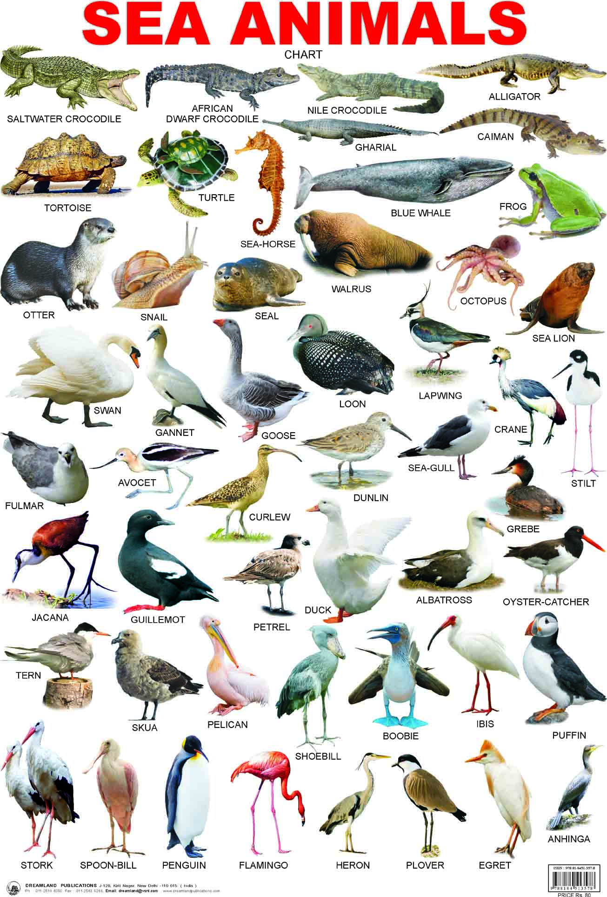
We will probably do some sea animal art, sea animal play, and sea animal reading and writing.
We will see and toy sea animals,
but also see some pictures of real sea animals.

Slide 5
Sea animals are usually fun and interesting
to talk and play about.

