Slide 1
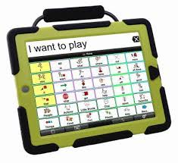
A New Talker

Slide 2
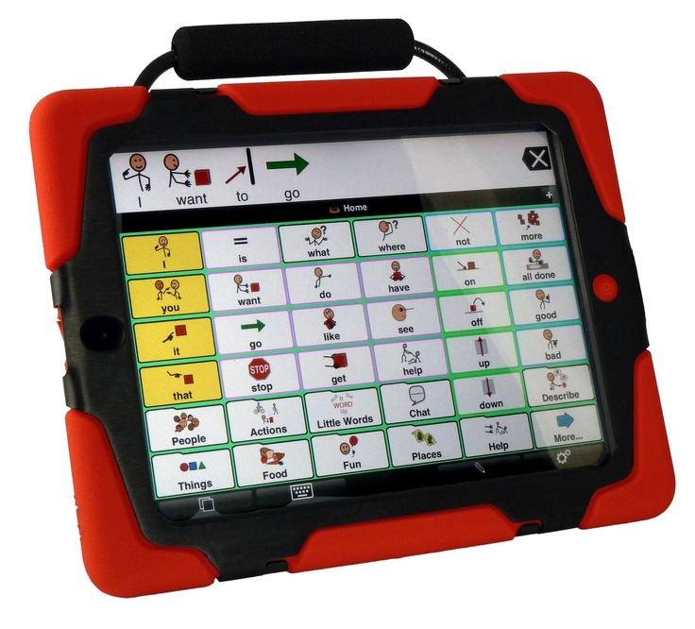
People talk in many ways. They say words. They write. They use their faces and bodies.
Some people also use Talkers.

Slide 3
At Speech, I sometimes use a Talker. I use it to tell people what I want, or what I think. ___ uses it, too.
We use the Talker when we read on the computer and when we do experiments. The Talker stays at Speech.

Slide 4
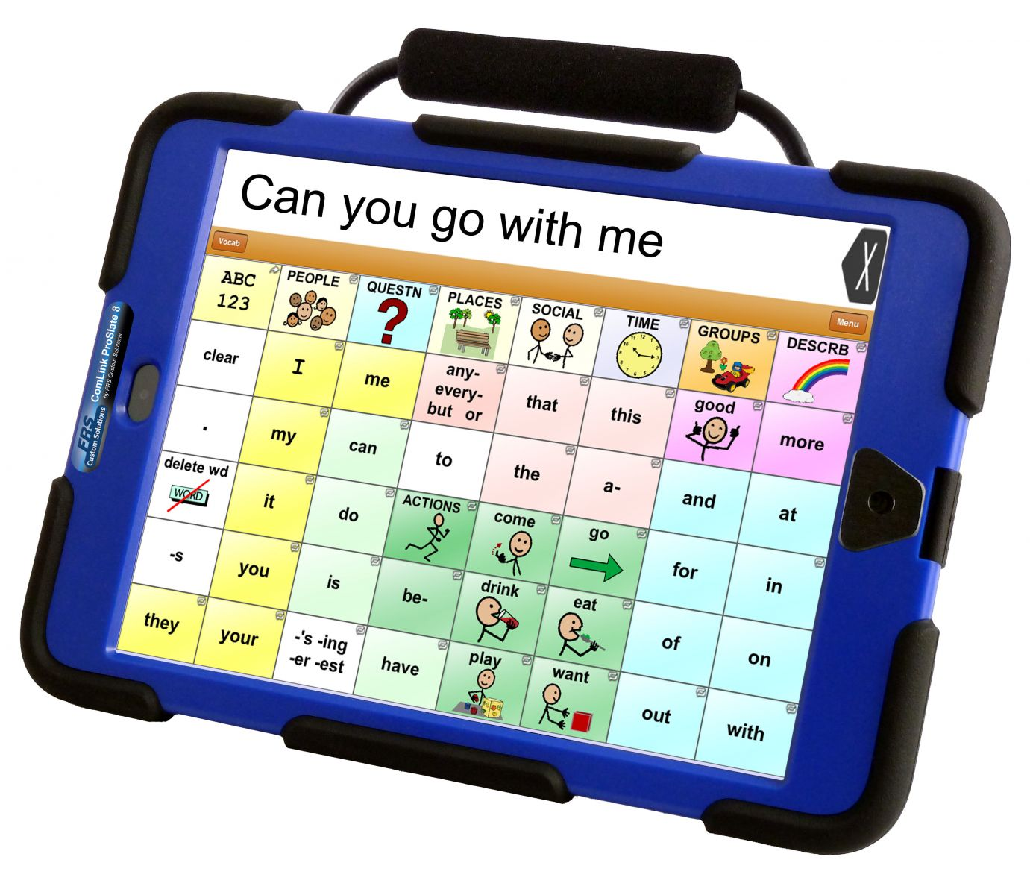
The Talker is very special. It is important to take good care of the Talker so that it works well and doesn’t break.
We take good care of it by touching it gently.
We take good care of it by carrying it carefully.

Slide 5
Soon, I may get a Talker of my own. It will probably look a little bit like this.
My new Talker may be green.
My Talker may have different words and pictures on it.
It will be fun to use my new Talker.

Slide 6
It is important to take good care of my new Talker.
It is important to keep it safe.
My family will be happy to see me take good care of my Talker.

Slide 7
When I get my new Talker, I can use it at Speech with __ and __.
If I need help, they can help me.
I will try to take good care of my new Talker.
They will be happy about that.

Slide 8
It is important to take good care of my new Talker.
It is important to touch it gently.
My family will be happy to see me take good care of my Talker.

Slide 9
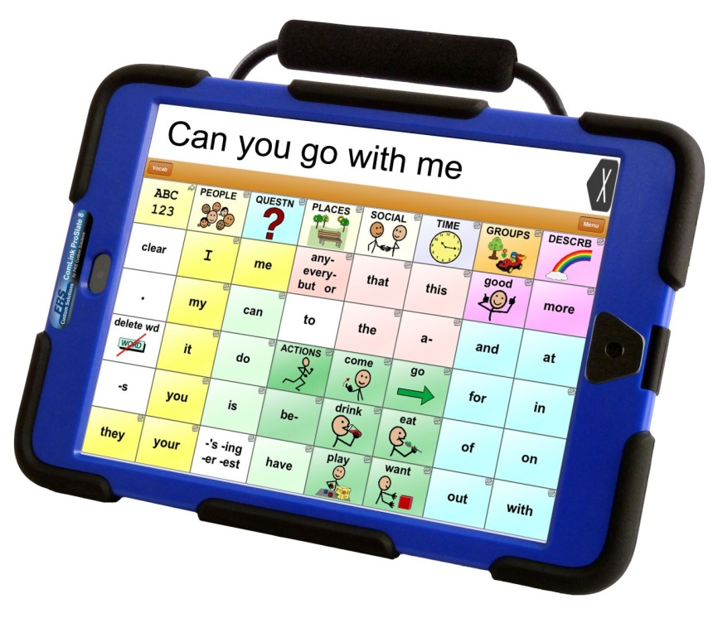
When I get my new Talker, I may be able to take it home. My family will like my new Talker. They can use it, too.
If I need help, my parents can help me.
I will try to take good care of my new Talker.
My family will be happy about that.

Slide 10
It is important to take good care of my new Talker.
It is important to carry it carefully.
My family will be happy to see me take good care of my Talker.

Slide 11
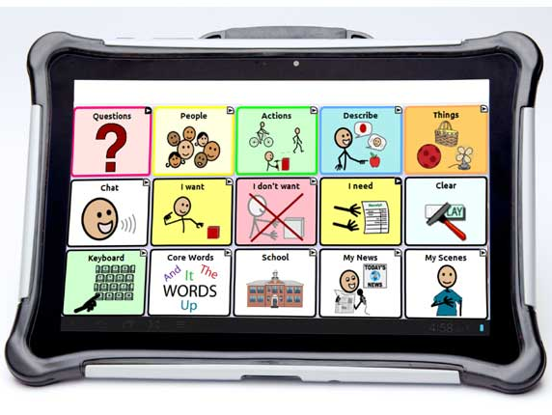
I can use my new Talker to tell my family what I want. I can use my new Talker to tell my family what I am thinking.
My family will be happy about that.
They can use the Talker, too.

Slide 12
It is good to have a Talker. It is important to take good care of the Talker so that we can use it to talk.
It can help me tell people what I want. It can help me tell people what I am thinking.

