Slide 1
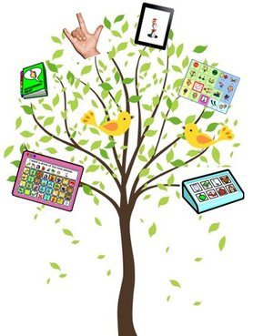
Tracking Early Communication Skills
PrAACtical AAC
www.PrAACticalAAC.org

Slide 2
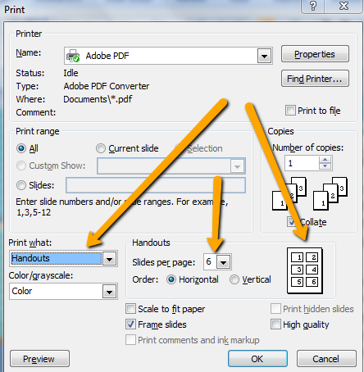
Using This Packet
This packet is designed to assist SLPs & educators who are supporting the early communication skills of beginning communicators. The Communication Dictionary is a place to record what the student does that is communicative, what it means, & how the adult partner should respond. By sharing this with others, everyone will be better attuned to the student’s individual ways of communicating & respond in a consistent way. This expedites progress for beginning communicators. For more information on this intervention, search ‘Beginning Communicator’ on www.PrAACticalAAC.org.
Directions for the Communication Dictionary:
Download & save the file.
Modify the Communication Dictionary, as needed.
Add the student’s name, ways of communicating, and
suggested responses.
Print the slide version for full-sized copies or select
handout option. Set desired number of slides per page based on
the size you want.
Attribution: Please feel free to share with families & colleagues using
professional standards for attribution. These materials were created
by PrAACtical AAC (www.PrAACticalAAC.org).

Slide 3
Communication Dictionary
Sample Dictionary
What I Do | What It Means | What YOU Can Do

Slide 4
Communication Dictionary
Name:
What I Do | What It Means | What YOU Can Do

Slide 5
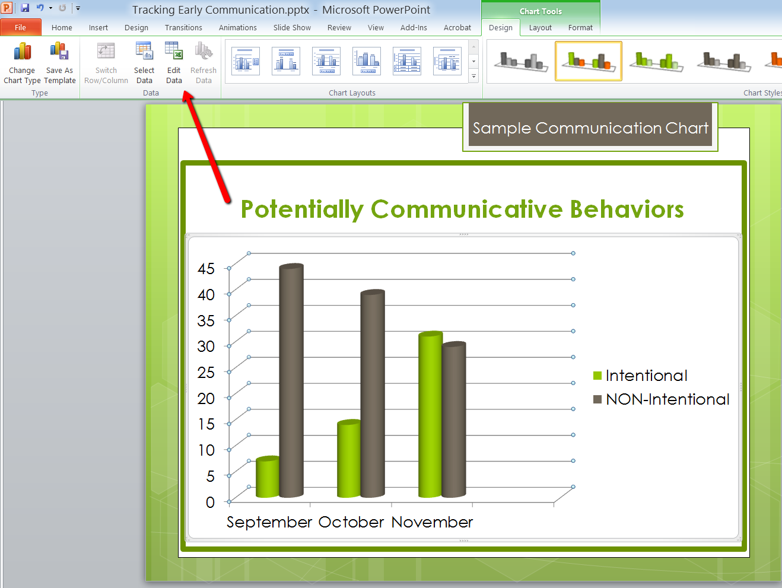
Using The Communication Tracker
This tool can be used to assist SLPs and educators in tracking the early communication skills of beginning communicators. The template includes a bar chart showing changes in communication. It is especially useful for students who do not seem to be communicating intentionally.
Directions:
Download & save the file.
Modify the Communication
Tracker, as needed. Begin
by clicking on ‘Edit Data.’
Duplicate slides, if needed

Slide 6
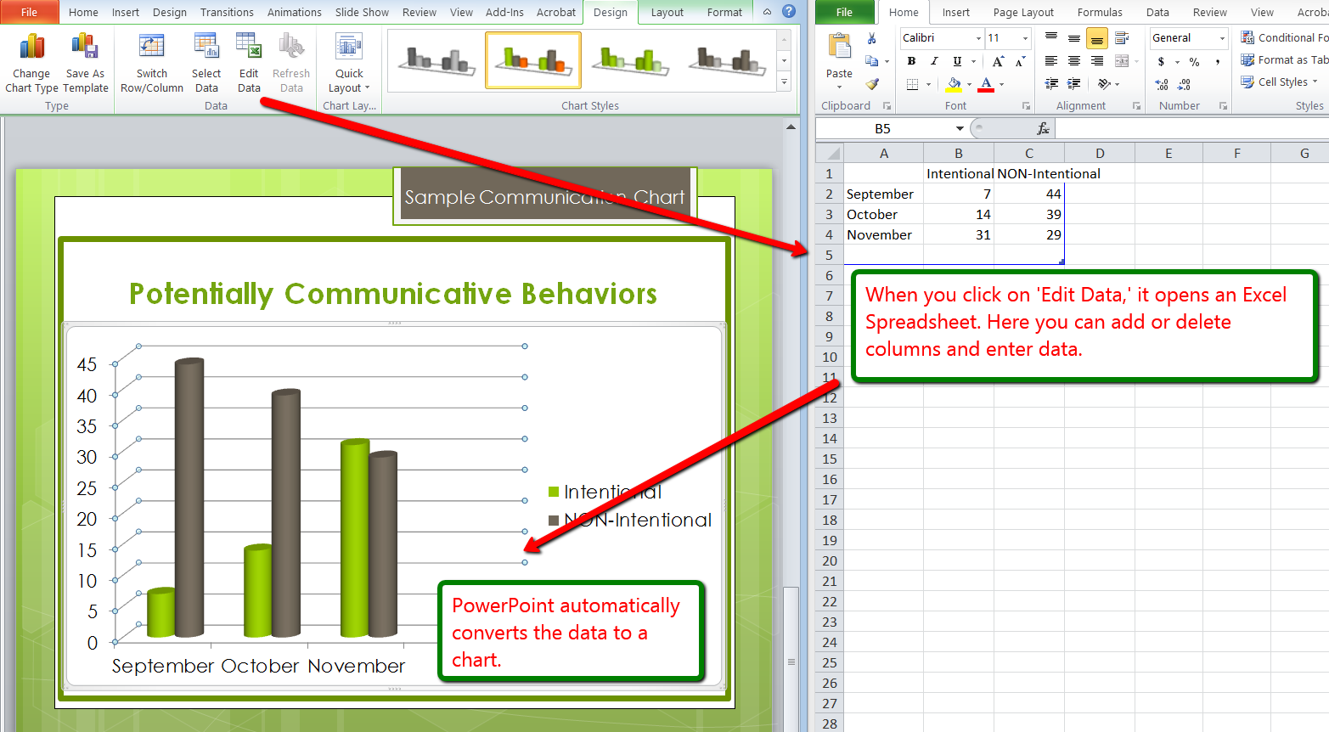

Slide 7
Potentially Communicative Behaviors
Sample Communication Chart

Slide 8
Student Name: Julian
Example

Slide 9
Student Name:

Slide 10
Student Name:

