Slide 1
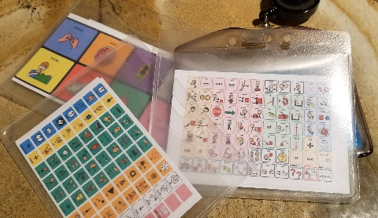
Mini Communication Boards
These can be printed out and used for AAC modeling.
The ‘Notes’ section of each slide lists the name of the AAC app that the board is based on & links to the original file.
This PowerPoint file is editable so that you can re-size the images to meet your specific needs.

Slide 2
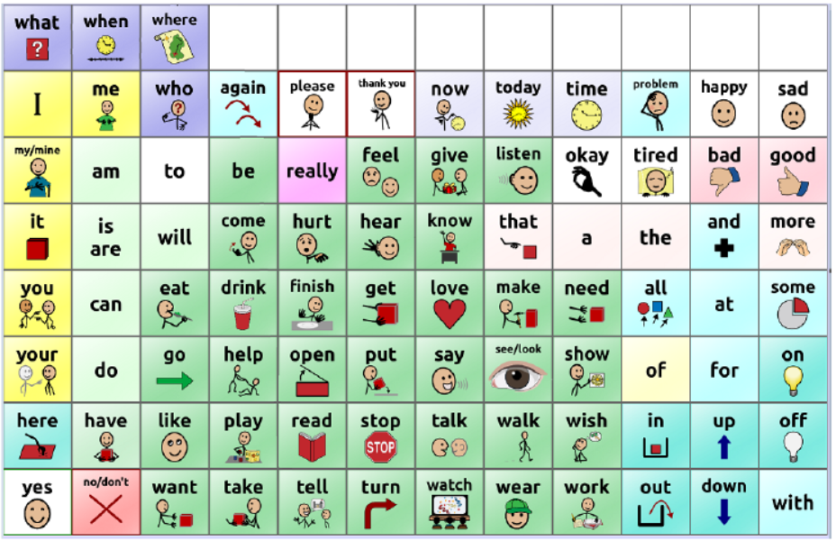
Notes:
PRC Saltillo WordPower 60 Basic
https://saltillo.com/downloads/chat/low-tech-communication-board-options/SINGLE%20PAGE%2096%20location_WP%2060%20basic%20SS%20communication%20board%20with%20blanks.pdf

Slide 3
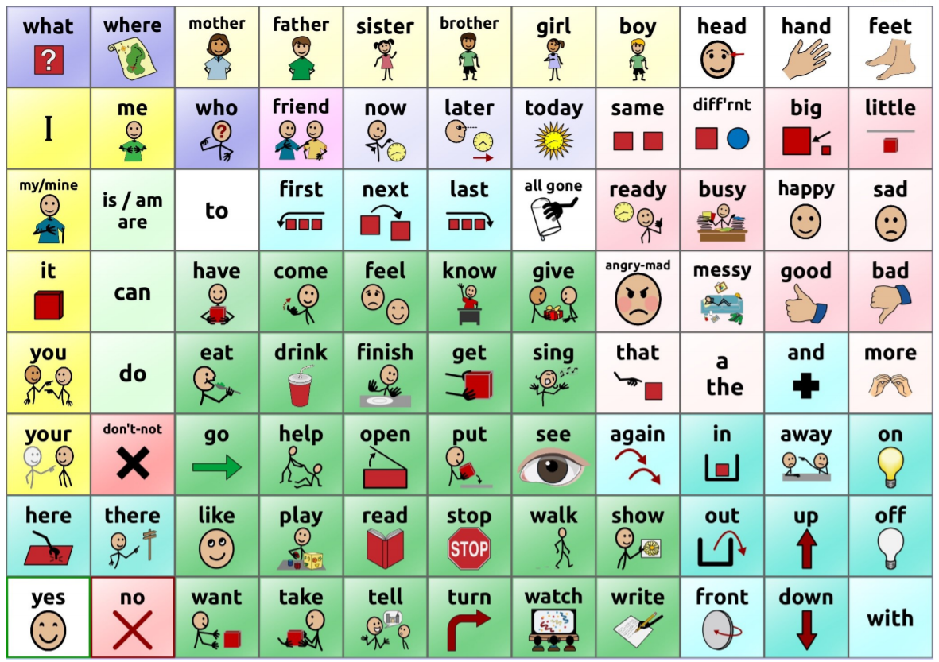
Notes:
PRC Saltillo WordPower 60 Basic TELL ME
https://saltillo.com/downloads/chat/low-tech-communication-board-options/SINGLE%20PAGE%20TELL%20ME%20Fall%202018.pdf

Slide 4
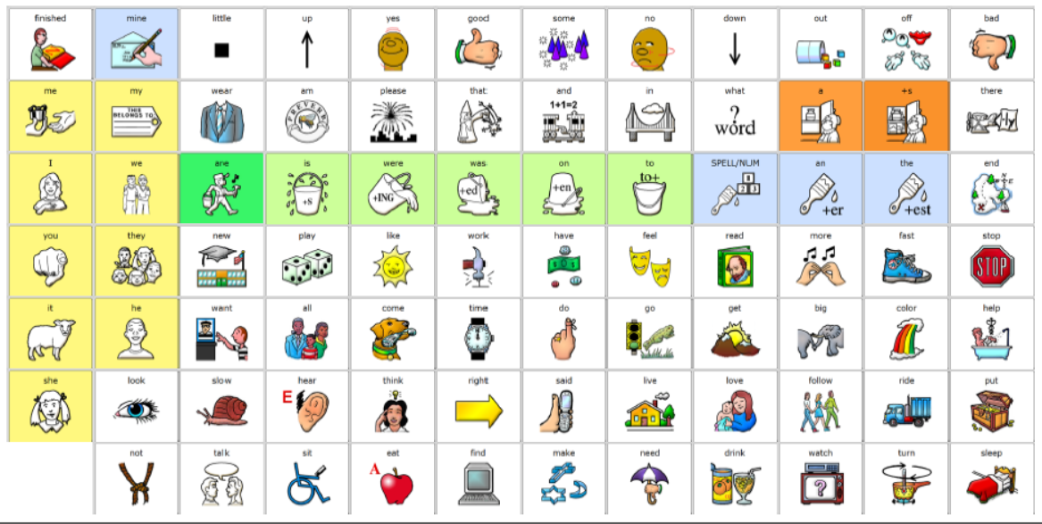
Notes:
LAMP Words for Life

Slide 5
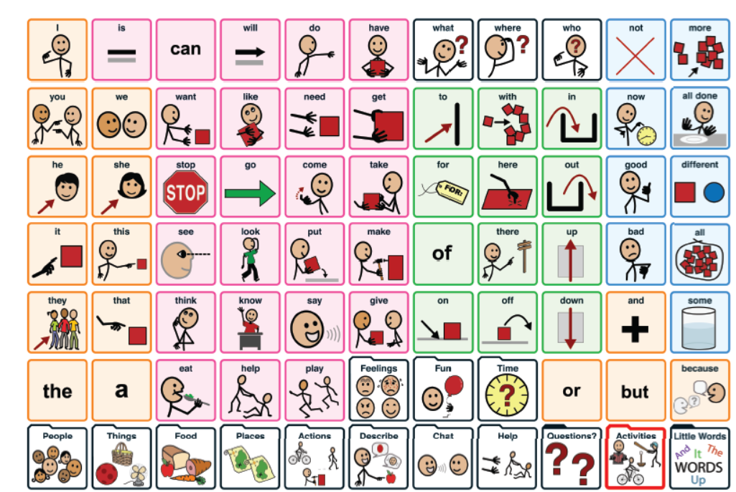
Notes:
Assistiveware Proloquo2Go Crescendo
https://coreword.assistiveware.com/uploads/db6476/original/2X/f/f824d99e68e3e58f9ab80d826e1abb2d737ba243.pdf

Slide 6
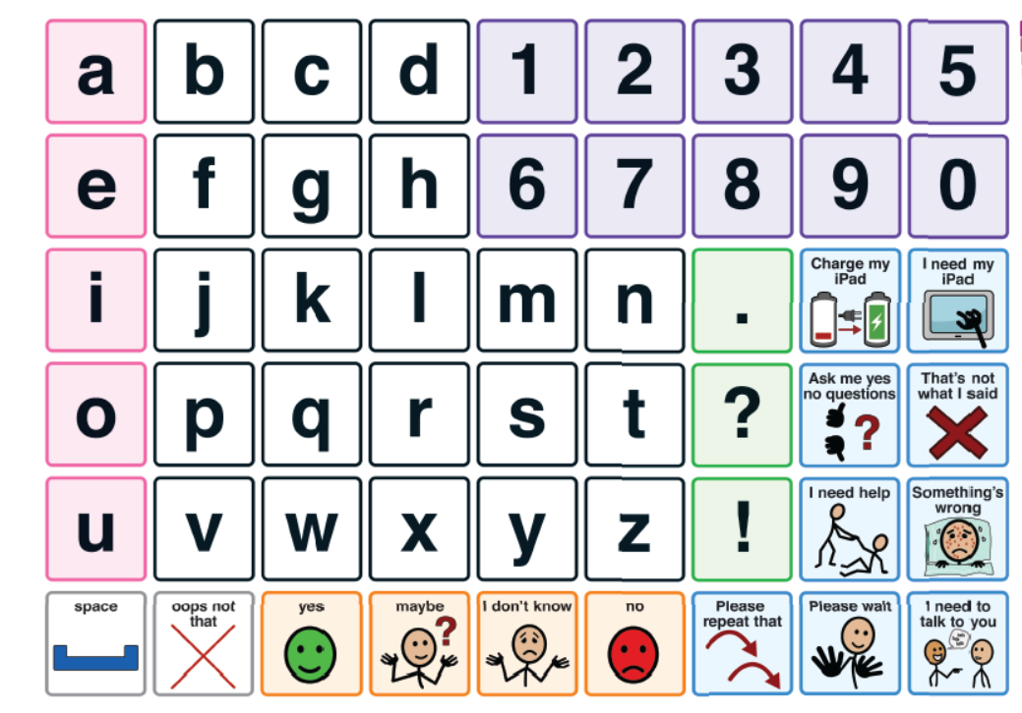
Notes:
Assistiveware Proloquo2Go Alphabet Page
https://coreword.assistiveware.com/uploads/db6476/original/2X/e/e46298523e608d9d0c96e247af1a6305a61eb888.pdf

Slide 7
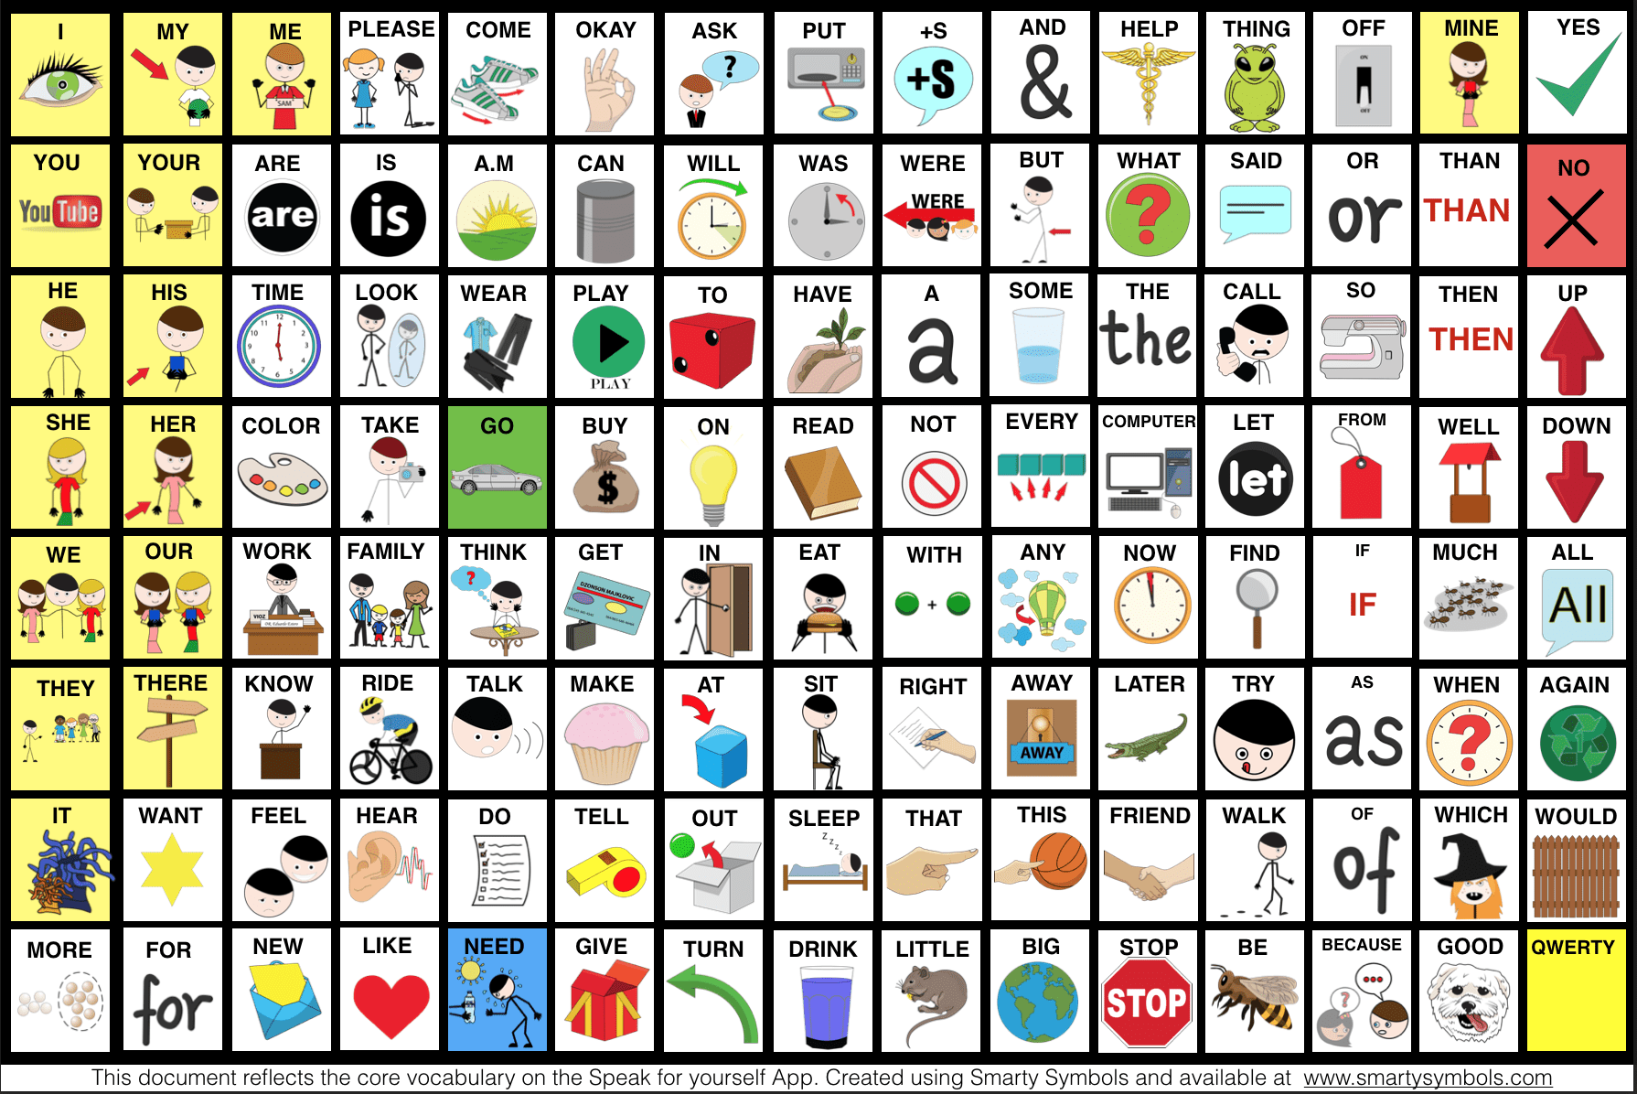
Notes:
Speak for Yourself (Smarty Symbols)
https://smartysymbols.com/speak-for-yourself-updated-symbols-key/

Slide 8
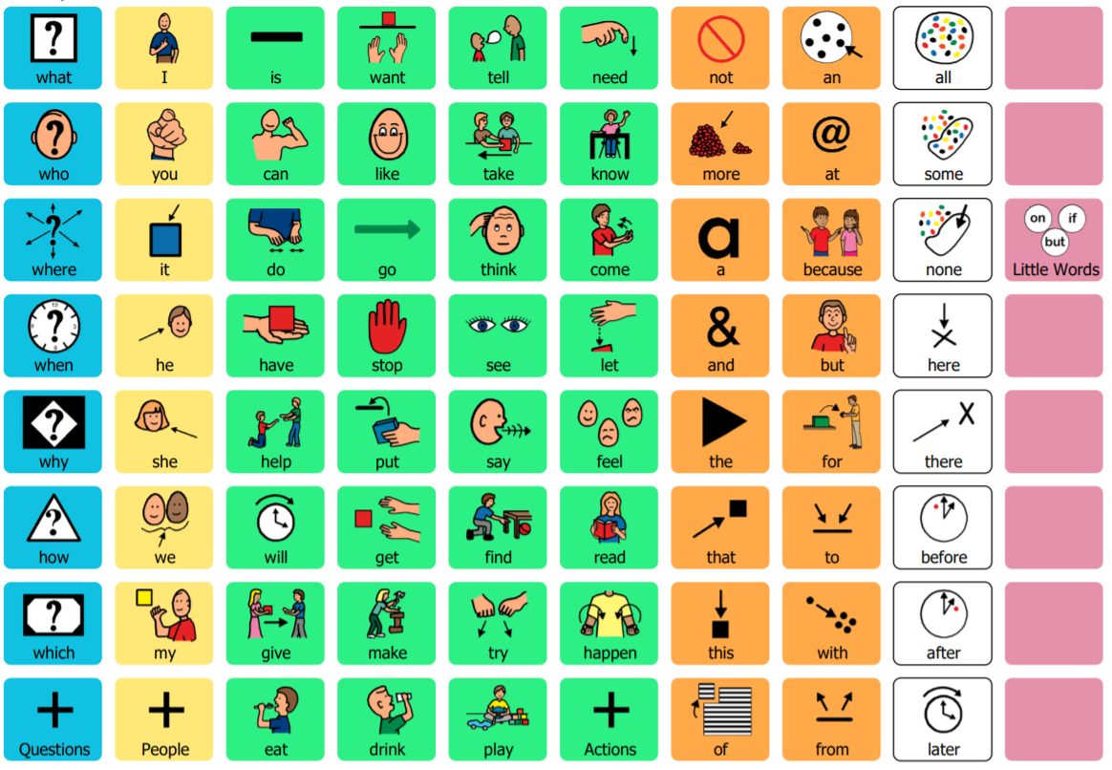
Notes:
Tobii Dynavox Core First
https://www.tobiidynavox.com/globalassets/downloads/products/software/snap/core-first-8x10.pdf

Slide 9
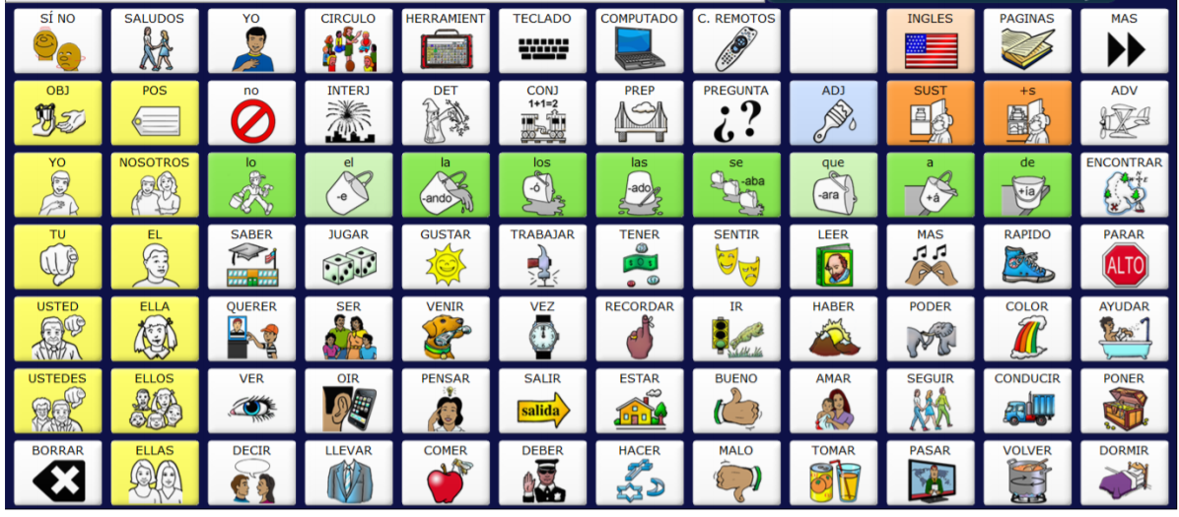
Notes:
PRC Saltillo Unidad Spanish
https://aaclanguagelab.com/materials/84_UNIDAD_SpanEng.pdf

Slide 10
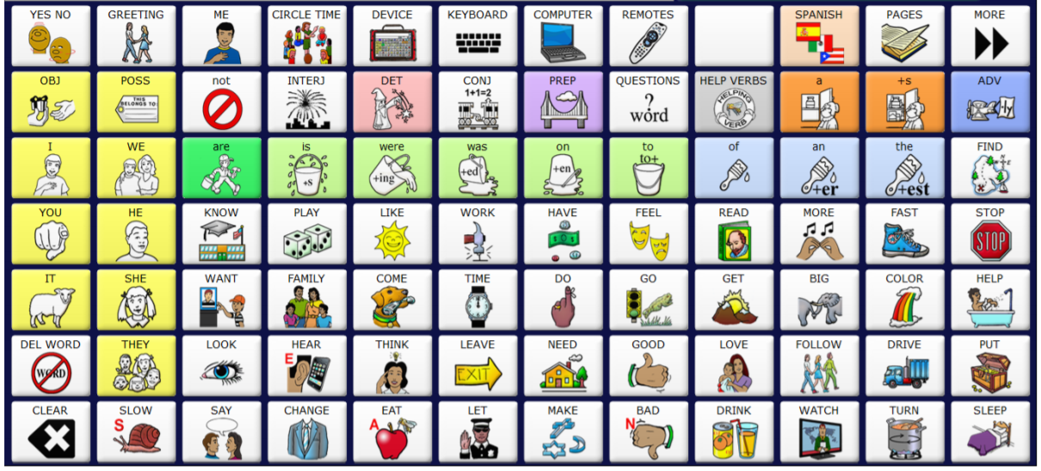
Notes:
PRC Saltillo Unidad English
https://aaclanguagelab.com/materials/84_UNIDAD_SpanEng.pdf

Slide 11
Notes:
PRC Saltillo CoreScanner
https://aaclanguagelab.com/materials/cornerstone_manual_board.pdf

