Slide 1
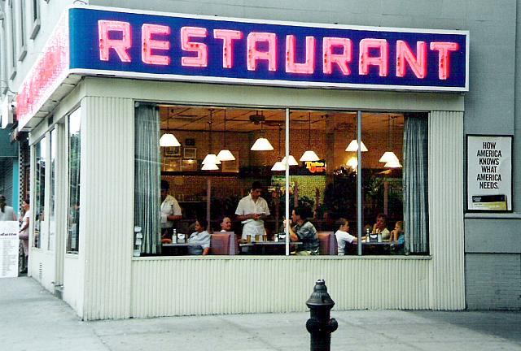
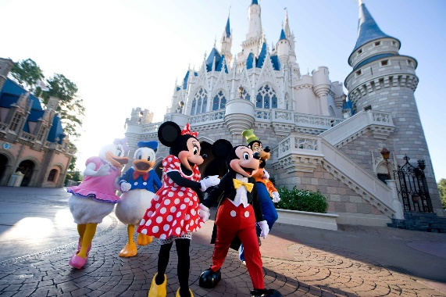
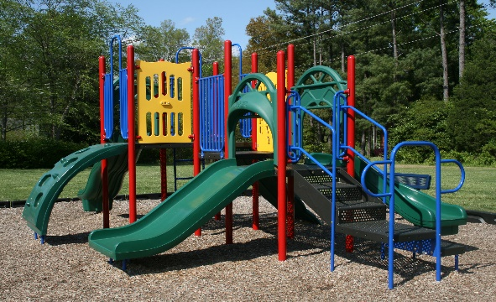
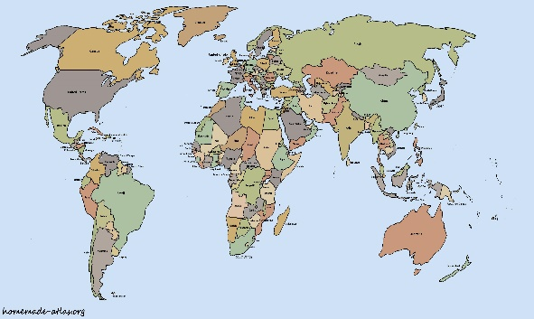
Where is your favorite place to go?

Slide 2
Language Experience Surveys
Activity: AAC learner moves around the room/building to ask a specific survey question to peers and staff. The communication partner responds and converses, providing additional communication opportunities for the student/client. If desired, they can be directed to record their choices on the visual support for the survey.
Directions:
Determine the target skill or goal area
Identify the vocabulary or message
Create a script, if needed

Slide 3
What?

Slide 4
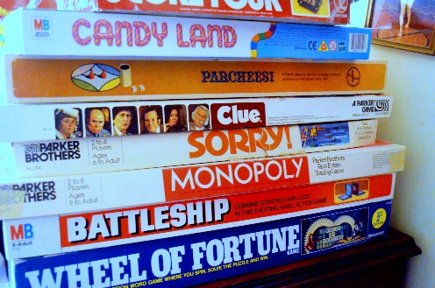
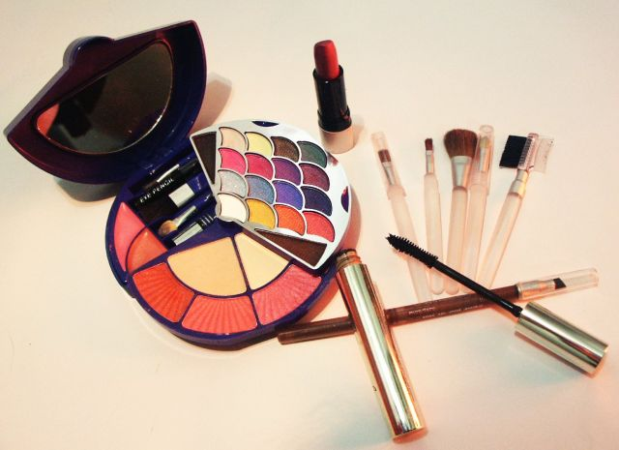
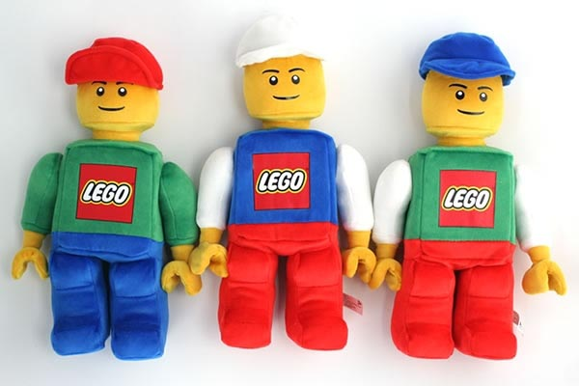
What do you want for your birthday?

