Slide 1
Alphabet cards
PrAACtical AAC
www.PrAACticalAAC.org

Slide 2
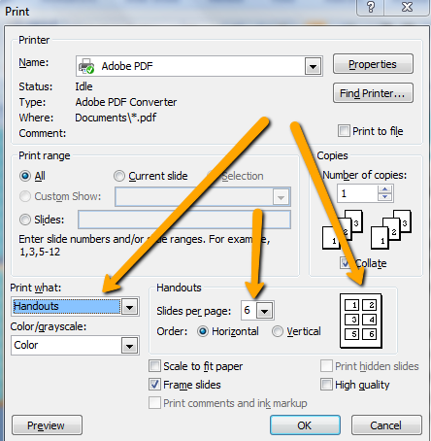
Using these Alphabet Cards
These cards are designed for people whose speech is unclear. They can use cards like these to spell out messages. They can also use them to indicate the initial letter of the word they are saying so that the listener is better able to guess what they are saying. E.g., P + ‘Ehnzil’ = Pencil
Directions:
Download & save the file.
Modify, as needed.
For printing, select the handout option. Set desired number of slides per page based on the size you want. Print the slide version for a full-sized copy.
Print & laminate.
Teach the communicator to either spell out
the message OR point to the first letter of
the word they are saying.
Attribution: Please feel free to share with families &
colleagues using professional standards for attribution.
These materials were created by PrAACtical AAC
(www.PrAACticalAAC.org).

Slide 3
A | B | C | D |  | Yes
E | F | G | H
I | J | K | L | M | N
0 | P | Q | R | S | T
U | V | W | X | Y | Z
New word | Not right | Start over | Next word | Thanks | No

Slide 4
A | B | C | D |  | Yes
E | F | G | H
I | J | K | L | M | N
0 | P | Q | R | S | T
U | V | W | X | Y | Z
New word | Not right | Start over | Next word | Thanks | No

Slide 5
A | B | C | D |  | Yes
E | F | G | H
I | J | K | L | M | N
0 | P | Q | R | S | T
U | V | W | X | Y | Z
0 1 2 3 4 5 6 7 8 9 10
New word | Not right | Start over | Next word | Thanks | No

Slide 6
A | B | C | D |  | Yes
E | F | G | H
I | J | K | L | M | N
0 | P | Q | R | S | T
U | V | W | X | Y | Z
0 1 2 3 4 5 6 7 8 9 10
New word | Not right | Start over | Next word | Thanks | No

Slide 7
A | B | C | D | E | F
G | H | I | J | K | L
M | N | O | P | Q | R
S | T | U | V | W | X
Y | Z |  |  |  | Yes
New word | Not right | Start over | Next word |  | No

Slide 8
A | B | C | D | E | F
G | H | I | J | K | L
M | N | O | P | Q | R
S | T | U | V | W | X
Y | Z |  |  |  | Yes
New word | Not right | Start over | Next word |  | No

Slide 9
Q | W | E | R | T | Y | U | I | O | P
A | S | D | F | G | H | J | K | L | New Word
Z | X | C | V | B | N | M |  |  | Start Over
0 | 1 | 2 | 3 | 4 | 5 | 6 | 7 | 8 | 9
YES
I don’t know.
NO

Slide 10
Q | W | E | R | T | Y | U | I | O | P
A | S | D | F | G | H | J | K | L | New Word
Z | X | C | V | B | N | M |  |  | Start Over
0 | 1 | 2 | 3 | 4 | 5 | 6 | 7 | 8 | 9
YES
I don’t know.
NO

