Slide 1
How I Communicate
A template for you by
PrAACtical AAC

Slide 2
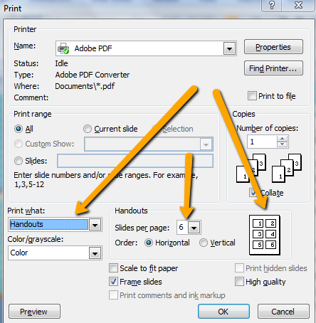
Using this Template
This template is designed to support people who communicate in ways that are subtle or somewhat unconventional. It should be completed by someone who is very knowledgeable about the learner’s ways of communicating. By sharing it with others, you can help them better understand what to look for in this learner, how to interpret those behaviors, and how to respond.
Directions:
Download & save the file. Duplicate slides, if needed.
In column 1, describe the subtle or unconventional communicative behavior. In the next columns, indicate what that behavior means and how the partner should respond.
Share with anyone who will be working with this learner.
For printing, select the handout option. Set desired number of slides per page based on the size you want.
Attribution: Please feel free to share with families & colleagues
using professional standards for attribution. These materials were
created by PrAACtical AAC (www.PrAACticalAAC.org).

Slide 3
Example
How I Communicate
What I Do | What It Means | What YOU Should Do
Rock excitedly | “I like this!” “It’s fun!” | Talk about it with me. Help me do more of whatever it is.
Look at something you are holding | “I want that.” | Give it to me & help me use it. Talk about it with me.
Make a sound | “Pay attention to me!” | Acknowledge me. Play & talk to me.
Purse my lips | “No, thank you!” | Acknowledge that I don’t want it. Take it away or stop doing it.
Bend over at the waist | “I need to go to the bathroom.” | Take me to the bathroom or change me.

Slide 4
How I Communicate
What I Do | What It Means | What YOU Should Do

