Slide 1
See, Touch, Taste, and Smell Christmas!
By: Student
December, 2017

Slide 2
See the lights.

Slide 3
Touch the star.

Slide 4
See the ornaments.

Slide 5
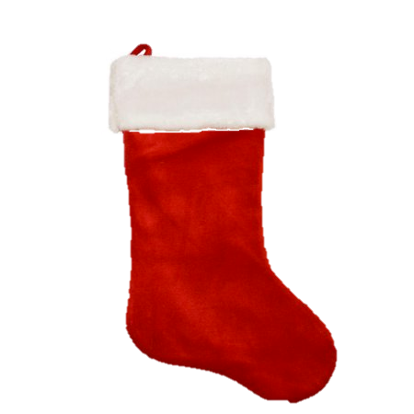
Touch the stocking.

Slide 6
Touch the bow.

Slide 7
Smell the pine cones.

Slide 8
See the snow globe.

Slide 9
Taste the candy cane.

Slide 10
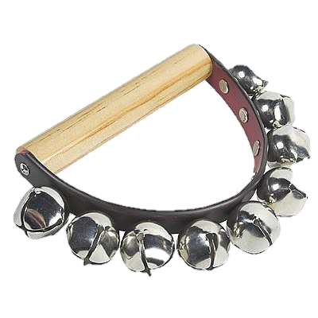
Listen to the jingle bells.

Slide 11
Let’s do it again!

