Slide 1
Speech-Language Pathology

Slide 2
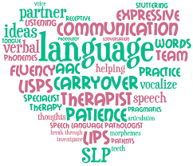
What is Speech-Language Pathology?
Speech-language pathologists (SLPs) work to prevent, assess, and provide treatment for children and adults with speech, language, social communication, cognitive, and swallowing disorders

Slide 3
Areas of expertise
Articulation
Fluency (Stuttering)
Voice
Swallowing
Language
Cognitive
Communication Modalities (AAC)
Social Aspects
Hearing

Slide 4
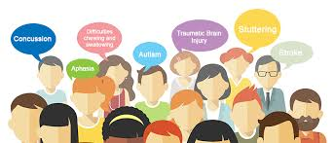
Who we help
People with:
Autism
Down Syndrome
Intellectual Disability
Cerebral Palsy
Apraxia
Aphasia
ALS
Parkinson's disease
Dementia
And more!

Slide 5
Where we work
In the home
Schools (preschool, elementary, junior high, high school)
Hospitals
Skilled nursing facilities
Outpatient clinics
Private practice
Inpatient rehab
Universities
Early Intervention

Slide 6
Why be an SLP?
Communication is the root to human connection!
Getting to watch clients grow and make progress
Being an advocate for special needs populations

Slide 7
How to become an SLP
Master's degree in Speech-Language Pathology (2 years)
Clinical Fellowship Position (9-12 months)
Bachelor's degree (4 years)

Slide 8
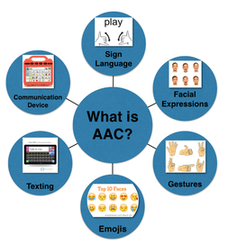
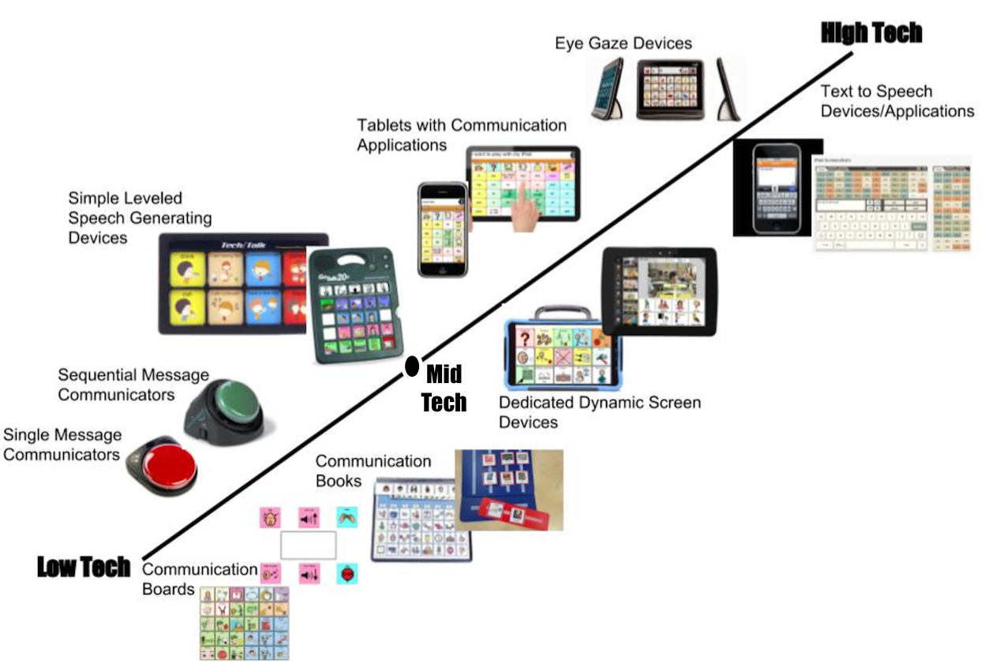
What is AAC?
Augmentative and Alternative Communication
Augment: make something greater by adding to it; supplement
Alternative: use modality other than oral speech

Slide 9
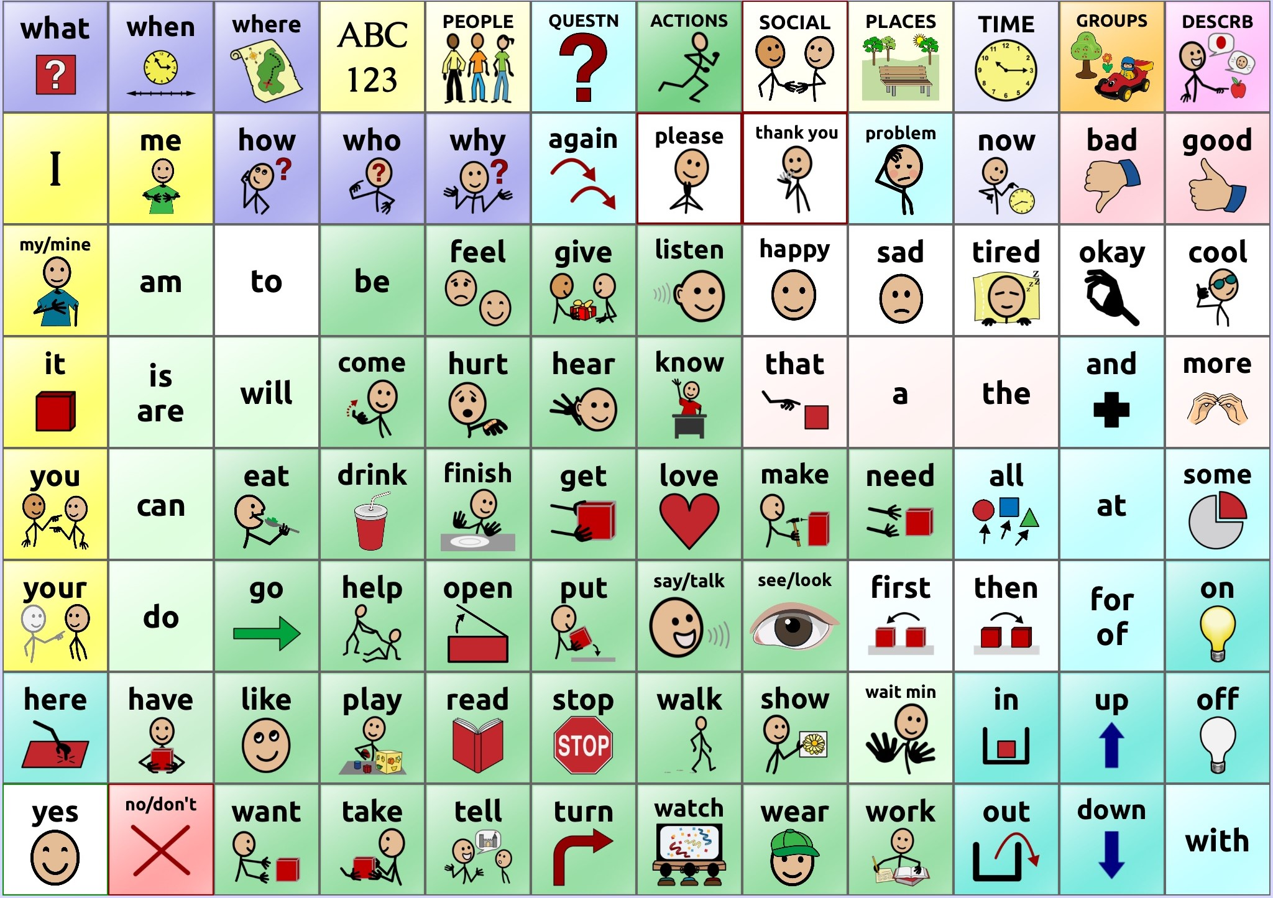
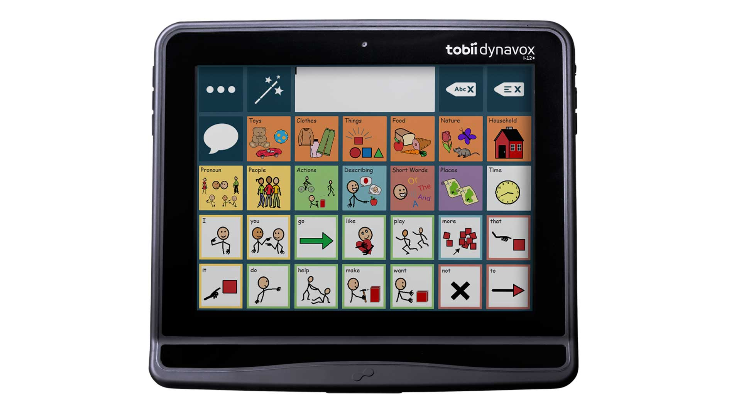
Types of AAC
Gestures/Facial Expressions
Low-Tech Communication Boards
High-Tech Speech Generating Devices

Slide 10
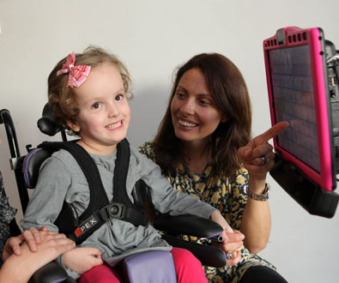
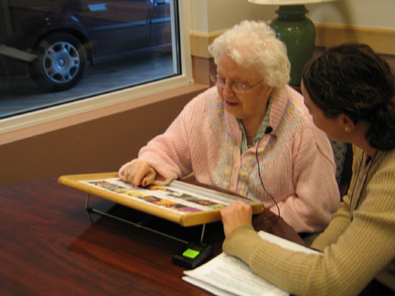
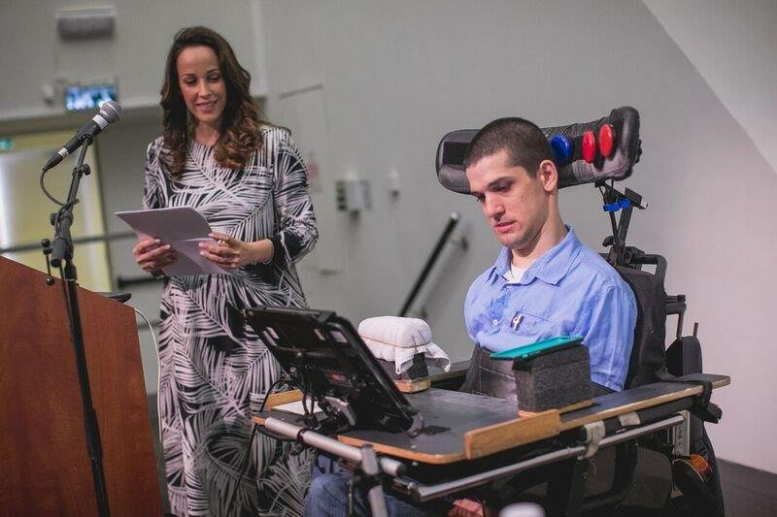
Who uses AAC
Notes:
People of all different ages! Some people are born needing to use AAC because they might have autism or cerebral palsy, both things which may mean that they aren't going to talk in the same way as you and me.
Adults can also need to use them later in life, if they have something happen, like get ALS or have a stroke which makes it harder for them to talk, and AAC can be used to help give them their voice back.

Slide 11
Your turn!

