Slide 1
ABC Holidays! Read by Karen Natoci December, 2017

Slide 2
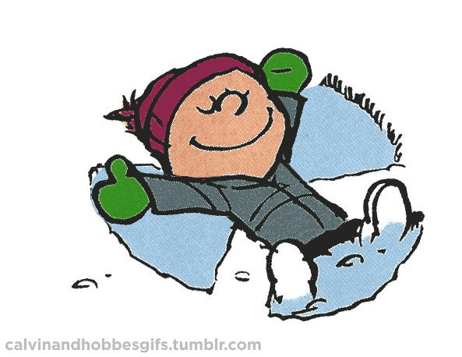
A is for snow Angels.

Slide 3
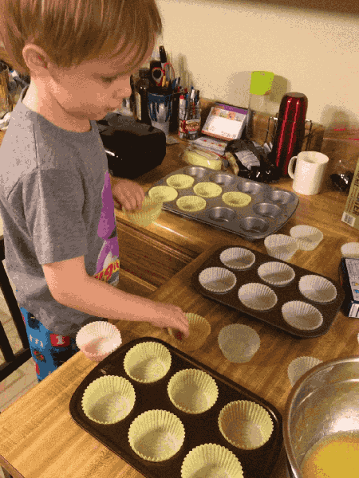
B is for Baking.

Slide 4
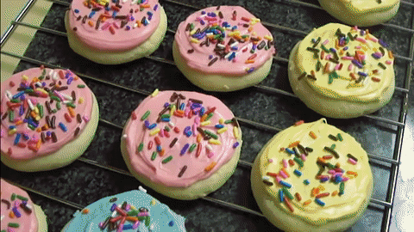
C is for Cookies.

Slide 5
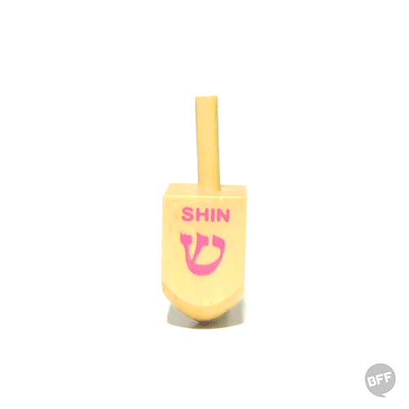
D is for Dreidel.

Slide 6
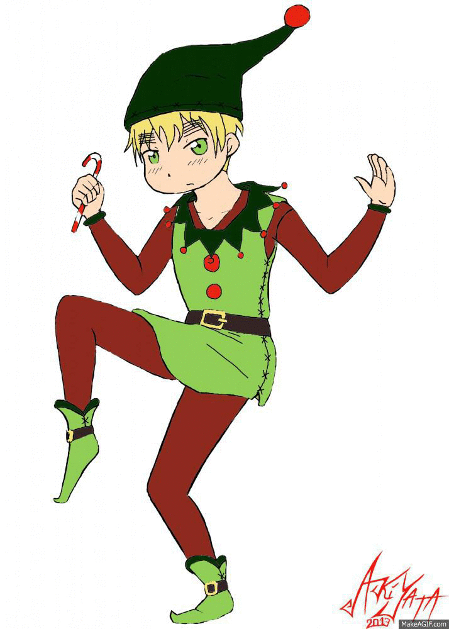
E is for Elf.

Slide 7
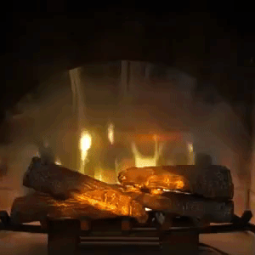
F is for Fireplace.

Slide 8
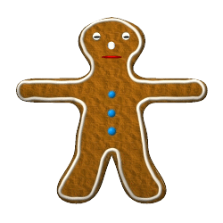
G is for the Gingerbread man.

Slide 9
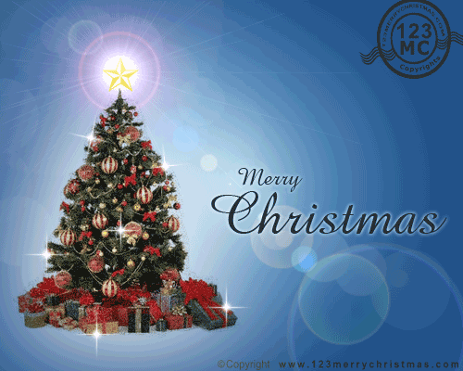
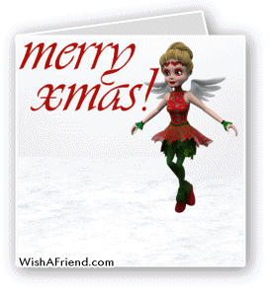
H is for Holiday cards.

Slide 10
I is for Icicles.

Slide 11
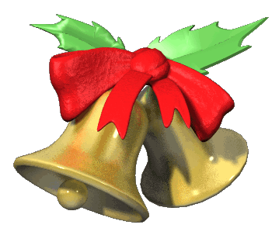
J is for Jingle Bells.

Slide 12
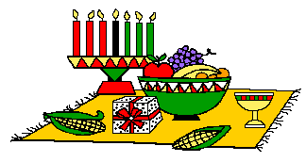
K is for Kwanzaa.

Slide 13
L is for Lights!

Slide 14
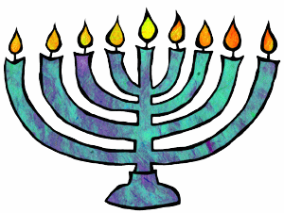
M is for Menorah.

Slide 15
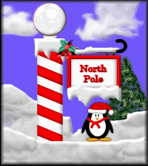
N is for the North Pole.

Slide 16
O is for Opening presents.

Slide 17
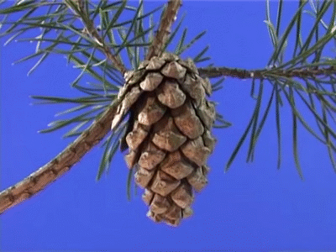
P is for Pine Cones.

Slide 18
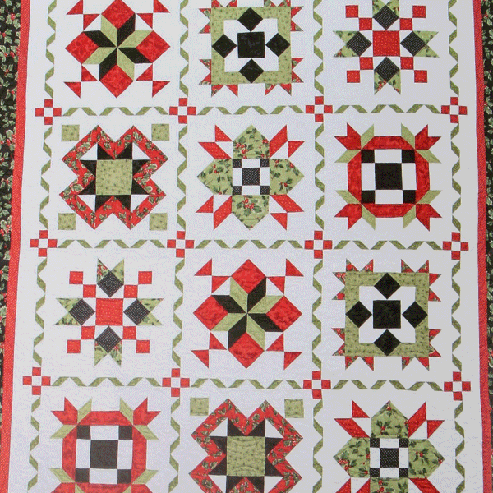
Q is for Quilt.

Slide 19
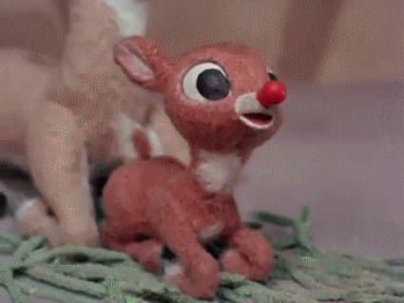
R is for Rudolf the red-nosed Reindeer.

Slide 20
S is for Snow globe.

Slide 21
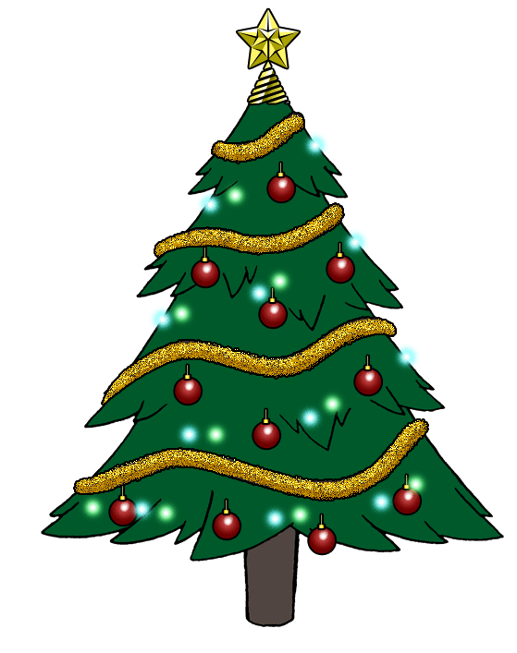
T is for the Christmas Tree!

Slide 22
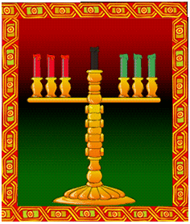
U is for Umoja (Unity).

Slide 23
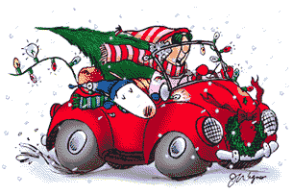
V is for Visiting family.

Slide 24
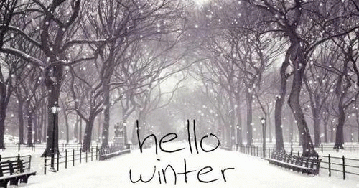
W is for Winter.

Slide 25
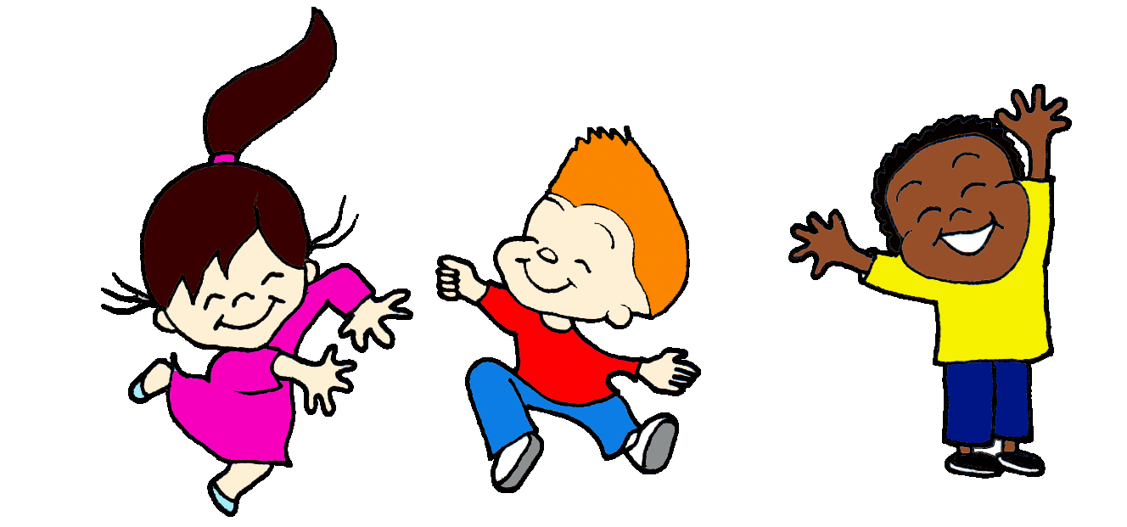
X is for Excited!

Slide 26
Y is for Yellow lights.

Slide 27
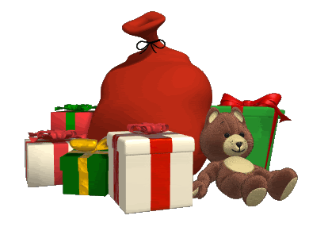
Z is for Zawadi (gifts).

