Slide 1
Let’s Talk About the Coronavirus (COVID-19)

Slide 2
You might hear about the virus from TV,
school, family, or friends. It is a new virus
that makes people feel sick. It is called
the Coronavirus or (COVID-19).

Slide 3
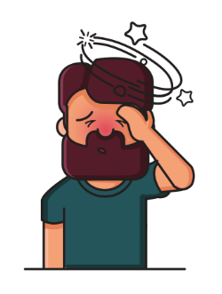
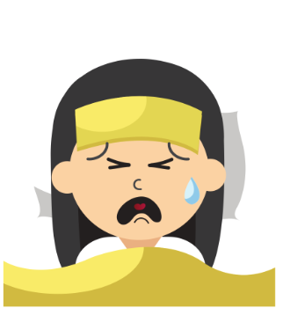
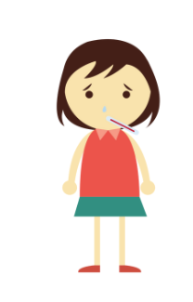
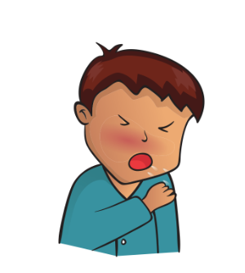
Coronavirus has symptoms like the flu. You may have a fever, cough, or difficulty breathing.

Slide 4
Not everyone who is sick, has the Coronavirus.

Slide 5
If someone has the virus they will: go to the doctor, stay home, or go to the hospital to feel better.

Slide 6
Coronavirus is contagious. There are some things that can help everyone stay healthy and safe.

Slide 7
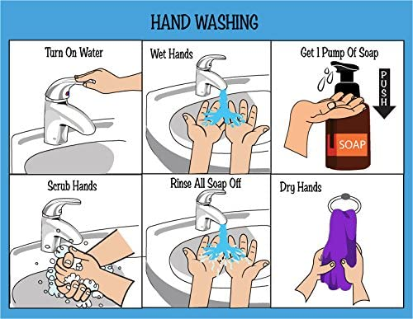
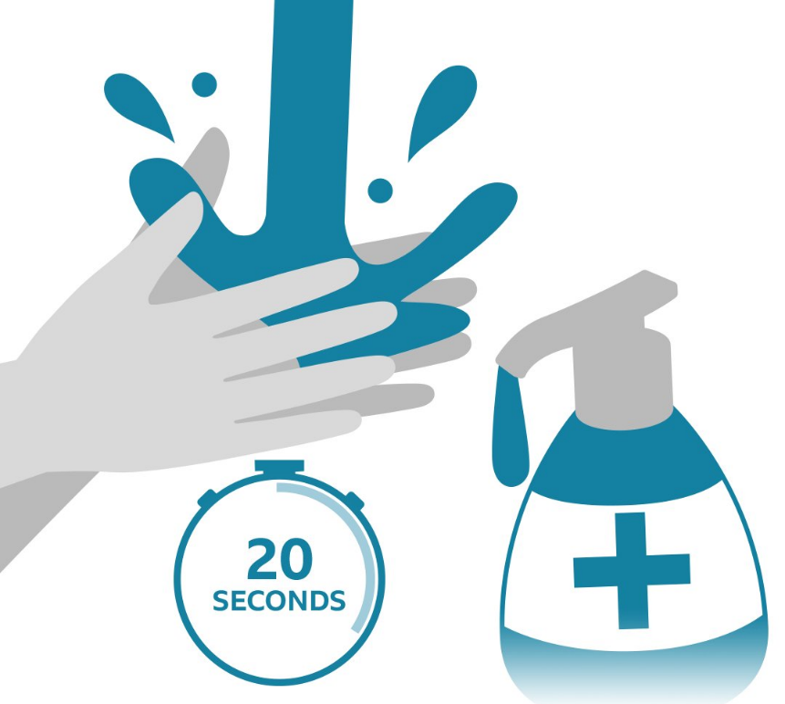
It is important to wash your hands! You can sing the song “Happy Birthday” 2 times, or
count out loud for 20 seconds.

Slide 8
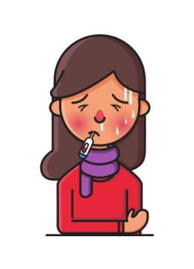
If you do not feel well, tell an adult.
The adult will know what to do next.

Slide 9
If you are sick you should see a doctor
and stay home to rest.

Slide 10
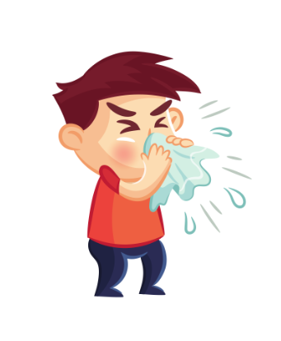
Remember to always cover your
mouth when you sneeze or cough
and to wash your hands right after.

Slide 11
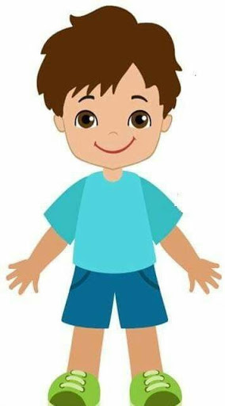
6 feet
If you see someone coughing or sneezing,
try to stay 6 feet away from them.

Slide 12
Avoid touching your eyes,
nose, and mouth.

Slide 13
These tips will help us stay healthy and safe!

Slide 14
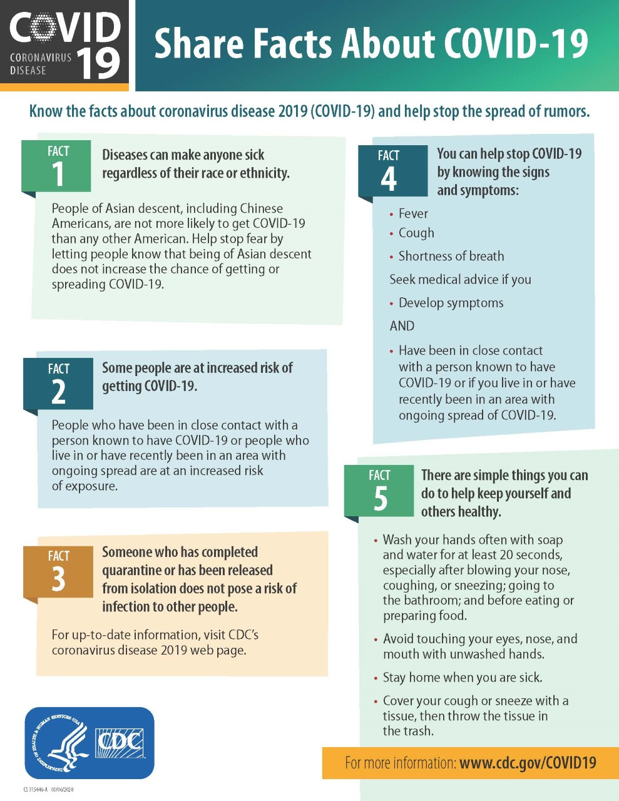
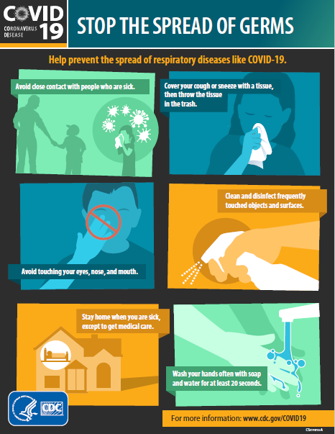
https://www.cdc.gov/coronavirus/2019-ncov/index.html

Slide 15
